Slide 1


Slide 2
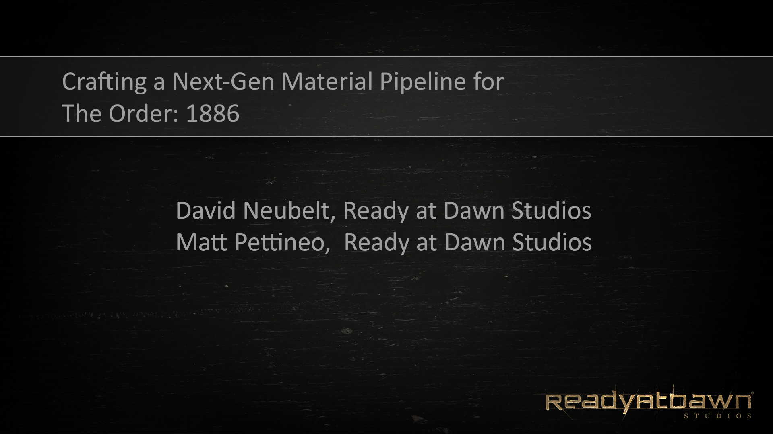
Notes:
Good morning everyone. My name is Matt Pettineo and this is my coworker David Neubelt, and we’re both lead graphics and engine programmers at Ready At Dawn Studios. Today we’re going to talk a bit about the technology and organization behind the material pipeline that we’ve developed for our upcoming game, The Order: 1886.

Slide 3
About Our Project
Brand-new IP
Alternate history 19th-century London
Exclusive to PlayStation 4
In-house engine
~80 developers
Notes:
I’d like to start off by briefly providing a bit of info about our project and our studio. The Order is a brand-new IP that we’re developing in-house at Ready At Dawn, and it takes place in an altenate-history version of 18th century London. What this means is that we have a mix of older fabrics, hairstyles, and locations mixed in with somewhat futuristic technology and effects. We’re exclusive to the PlayStation 4, which means we’re strictly targeting a very modern GPU feature set and we’re free to tailor our technology to that level of performance and flexibility. The game is using a new version of our in-house engine, and we have a team of about 80 developers currently working on the project.

Slide 4
Core Shading Model
Default specular BRDF is Cook-Torrance
D term is GGX distribution from Walter et al.
Matching Smith G term derived in same paper
Schlick’s approximation for Fresnel
Lambertian diffuse, balanced with specular intensity
Notes:
Now that the intro is out of the way, let’s dive right into some technical details about our shading model. Our default specular model is a Cook-Torrance microfacet BRDF, which we’ve been using some form of Cook-Torrance for nearly 2 years now. For our distribution term we’re using the GGX distribution described in Walter’s paper from 2007. We’re also using the matching Smith geometry term derived in the same paper, which is specifically formulated to ensure that the BRDF is normalized. For the most part we only have small tweaks and optimizations to the model presented in the paper, so I won’t go into full details here. If you’re interested, we have formulas and sample code in our course notes. As for the diffuse, we’re currently using standard Lambertian diffuse. To balance it with our specular model, we multiply it with the inverse of the specular intensity.

Slide 5
Core Shading Model
Other BRDFs available
Beckmann (also taken from Walter et al.)
Anisotropic GGX
Hair (Kajiya-Kay)
Skin (pre-integrated diffuse)
Cloth
Notes:
We use a tile-based forward renderer in our engine, which makes it easy for us to support multiple BRDF’s in order to express a wider variety of material types. We have another Cook-Torrance specular model, except we use a Beckmann distribution that follows the formulation from the Walter paper. He have an anisotropic variant of GGX, which is based on the material from Disney’s presentation at the shading course last year. For hair we’re using Kajiya-Kay at the moment, with an added secondary specular lobe to simulate the secondary specular exhibited by the Marschner model. Our skin BRDFis based off of Eric Penner’s work on pre-integrated skin shading, which essentially pre-integrates the scattering term into a lookup texture that’s indexed at runtime in the shader. Finally we have a cloth BRDF, which I’ll elaborate on in a few slides.

Slide 6
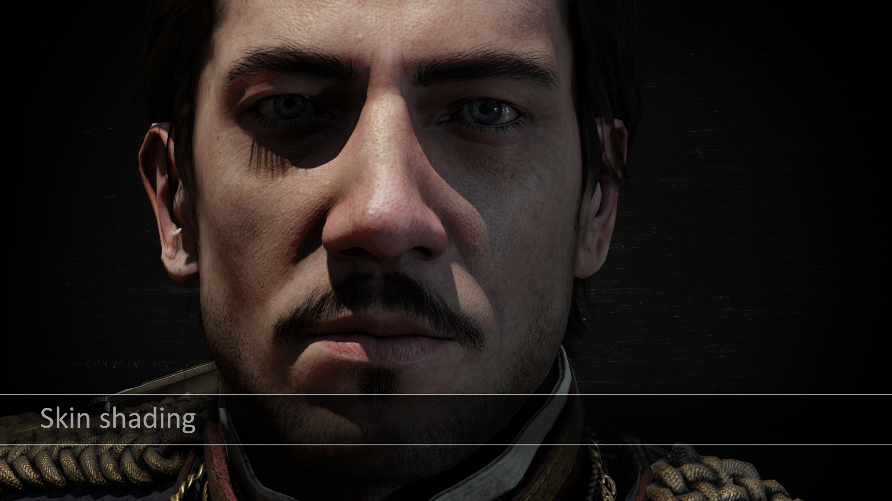
Notes:
Here is a screenshot showing our skin shading model being. used on one of our principle characters. You can see the scattering pretty clearly on the nose and cheeks

Slide 7
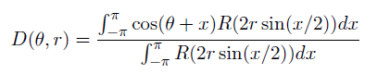
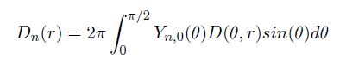
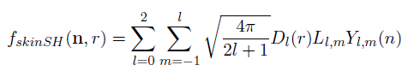
Skin
Pre-integrated skin diffuse with SH
Notes:
One issue we had to tackle with our skin shading was using our pre-integrated diffuse scattering term with our spherical harmonics lighting probes. Fortunately this is pretty simple to do with SH if you already know how to compute standard diffuse irradiance. With SH you can convolve a radially-symmetrical kernel with a lighting environment using a simple dot product, and for standard diffuse you use a clamped cosine as a kernel. All you need to do this is a representation of your kernel as zonal harmonics, so we compute that by numerically integrating the diffuse scattering function with the zonal harmonics basis functions. We then store those ZH coefficients in a lookup texture parameterized by surface curvature, and at runtime we sample the appropriate coefficients and use them to perform the dot product with the lighting environment stored in the probe.

Slide 8
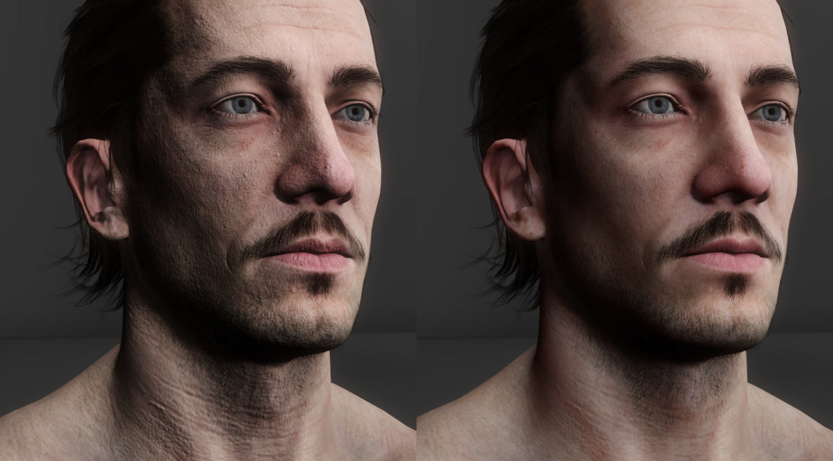
Ambient Skin (Diffuse only)
Left is using normal SH lighting convolved with cosine kernel
Right is using SH lighting convolved with the scattering kernel
Notes:
Here’s a comparison image that shows a character being lit only by a diffuse SH probe, with no specular. The left image is using a standard cosine kernel, and as you can see the skin looks unnaturally hard due to the lack of subsurface scattering. On the right we use the pre-integrated diffuse coefficients, and as you can see the result is much more natural.

Slide 9
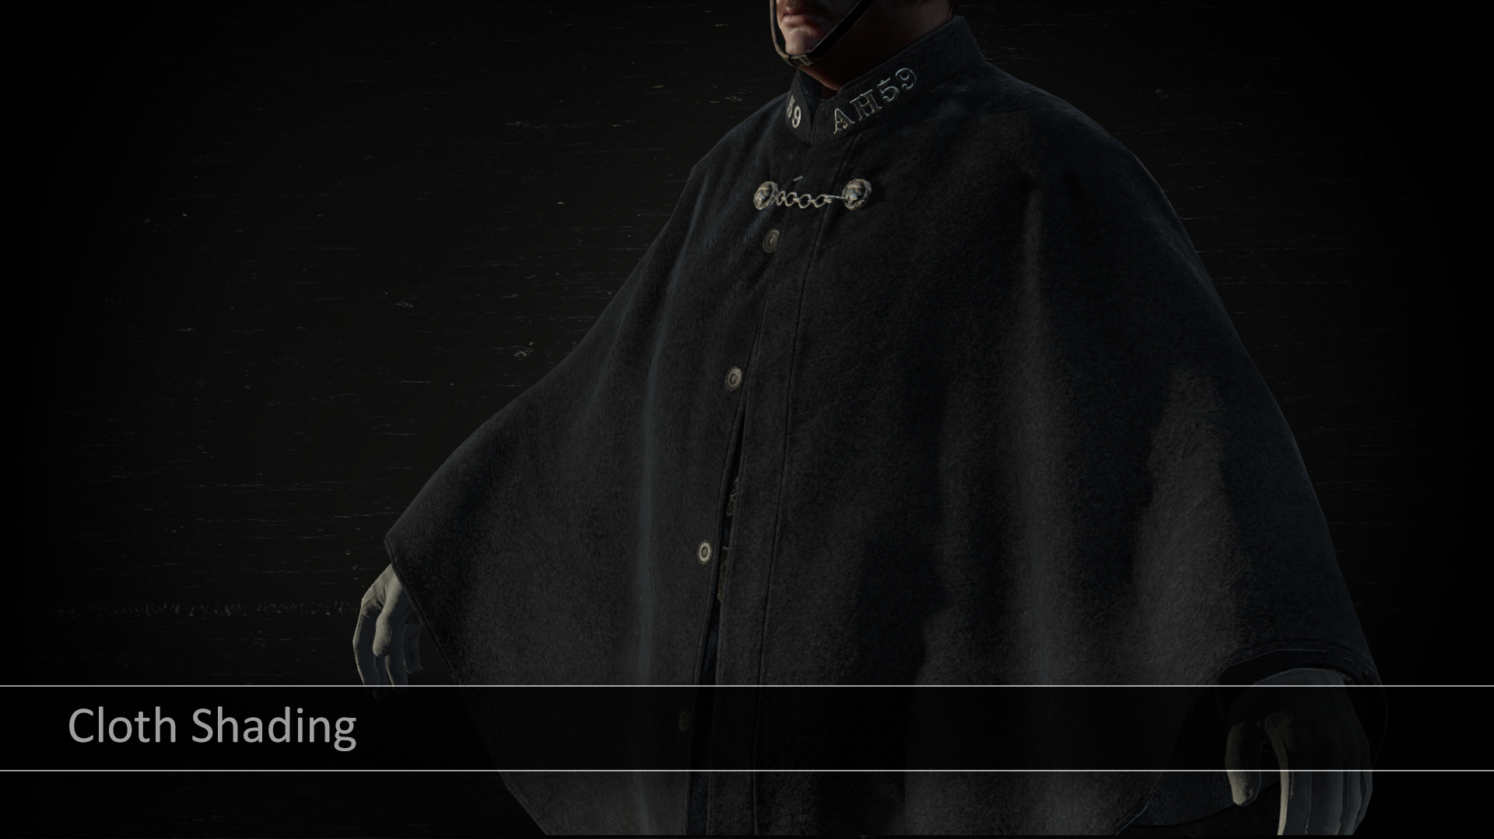
Notes:
Next up, I’m going to talk a bit about our cloth shading.

Slide 10
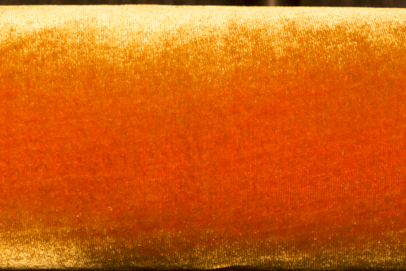

Cloth Shading
Observations from photo reference:
Soft specular lobe with large smooth falloffs
Fuzz on the rim from asperity scattering
Low specular contribution at front facing angles
Some fabrics have two toned specular colors
Notes:
When we were developing our cloth shader, we took some high-resolution photos of some real-world material samples in order to observe the key properties of those fabrics. On the right you see photograph of velvet wrapped around a cylinder, with the camera and light both placed at the same angle. The most noticeable aspect is the strong grazing specular on the edge of the cloth, which is due to asperity scattering through fibers that point away from the surface. For the front-facing areas there’s actually very little specular contribution, which is shows that the specular response is actually backwards compared to a typical microfacet BRDF. In fact to the right of velvet we have a rendering of a cylinder under the same lighting conditions using a Cook-Torrance BRDF with roughness of 1.0, and as you can see the reflectance is highest at the center and falls off towards the edges.

Slide 11
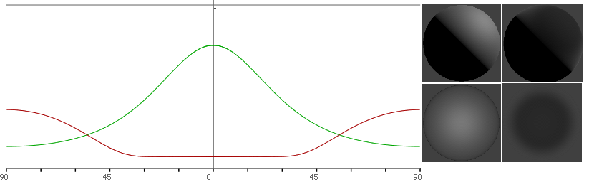
Cloth Shading
Inverted Gaussian for asperity scattering
Translation from origin to give more specular at front facing angles
No geometry term
Notes:
We ended up implementing a BRDF based on Michael Ashikhmin’s work that was presented in his paper entitled “Distribution-based BRDF’s” from 2007. The distribution term is an inverted Gaussian, which gives us the grazing specular response observed in the photo reference. We also offset the curve a bit in order to provide a soft specular at front-facing angles. Initially we attempted to use a Smith geometry term, however the results weren’t very encouraging. Ultimately we decided that it didn’t make sense to have a microfacet geometry term for a material like velvet, where the material is composed of translucent fibers that are perpendicular to the surface. This follows Ashikhmin’s results, who felt that a geometry term wasn’t necessary and fit his distribution to measured without using one.

Slide 12

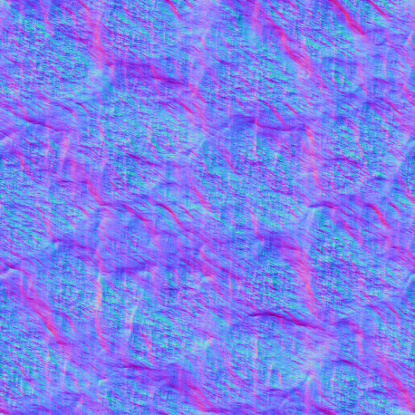
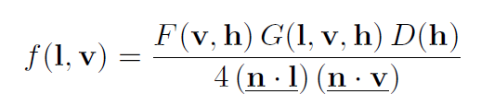
Specular Aliasing
+
=
Notes:
Now we’re going to talk a bit about specular aliasing. I’m sure most of you by now are familiar with the issue outlined on the slide, which is that physically-based specular models combined with high-frequency normal maps makes for some very sad developers. Fortunately there has been some good research in this area, and we have some options for mitigating this issue.

Slide 13
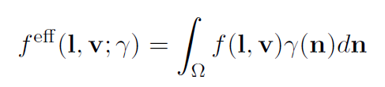
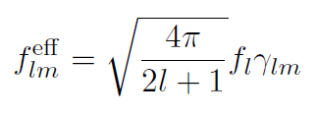
Specular Aliasing
Modify roughness maps to reduce aliasing
Using technique based on “Frequency Domain Normal Map Filtering” by Han et al.
Notes:
To remedy the issue in our own engine, we followed an approach similar to what Stephen Hill and Stephen McAuley presented last year at SIGGRAPH. Almost all of our materials use roughness maps that are auto-generated by content build pipeline, which is due to the compositing system that we’re going to talk about in a bit. This gives as an opportunity to modify the roughness values stored in the lower-resolution mip levels in such a way as to reduce aliasing. This gives us improved visuals with no additional storage or runtime cost. However instead of adjusting our roughness values by pre-baking Toksvig or CLEAN, we came up with a different approach based on “Frequency Domain Normal Map Filtering” by Han et al. The basic concept behind this paper is that you can convolve a BRDF with a normal distribution function in order to produce an effective BRDF that considers all normal within that NDF. So if you can represent all normal map texels within the footprint of a given pixel as and NDF and then convolve it, you’ll get the correct, antialiased result for that pixel. Of convolutions in the spatial domain are expensive, so Han utilized spherical harmonics to perform the convolution in the frequency domain. With spherical harmonics the convolution of a function with a radially symmetric kernel can be achieved with a simple dot product, which was demonstrated Ravi Ramamoorthi back in 2001.

Slide 14
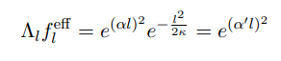
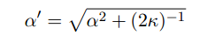
Specular Aliasing
Represent NDF as spherical Gaussian (vMF distribution)
Approximate BRDF in SH as a Gaussian
Convolution of two Gaussians is a new Gaussian
Use relationship to compute new roughness
BRDF
NDF
New Roughness
Notes:
Working purely in spherical harmonics isn’t a practical option for specular BRDF’s, since a prohibitive number of coefficients would be required to avoid attenuation of higher frequencies. Instead, Han represented NDF’s using the von-Mises Distribution which is basically a normalized Gaussian distribution located on the surface of a sphere. If we also approximate a specular BRDF as a Gaussian, we can then convolve the two Gaussians in the frequency domain to determine compute a new Gaussian representing the effective BRDF. By relating these new Gaussian with old Gaussian we can actually represent the effective BRDF as a modification of the roughness value, which is how we compute the modified roughness that we store in our roughness maps. This conceptually similar to what Michael Toksvig proposed in his technical report.

Slide 15
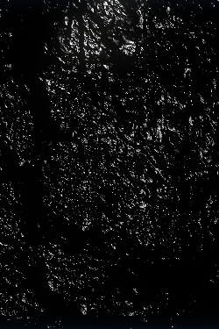
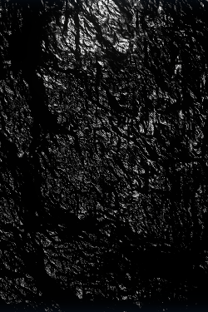
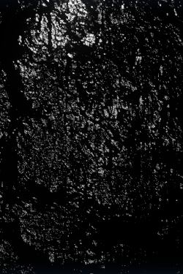
No AA
Ours
Ground Truth
Notes:
Here’s a quick comparison of how our technique looks when used with our shading model. The images show a flat plane lit by two point lights, with a high-frequency normal map that is being minified by the texture filtering hardware. The leftmost image has no specular antialiasing, the middle shows our method, and the rightmost image uses mipmapped texture-space lighting. It may be difficult to see on the slide, but our technique significantly reduces aliasing and compares well to the ground truth render. We have more comparison images in our course notes if you’re interested, or better yet you can download the sample code and see the results in motion.

Slide 16
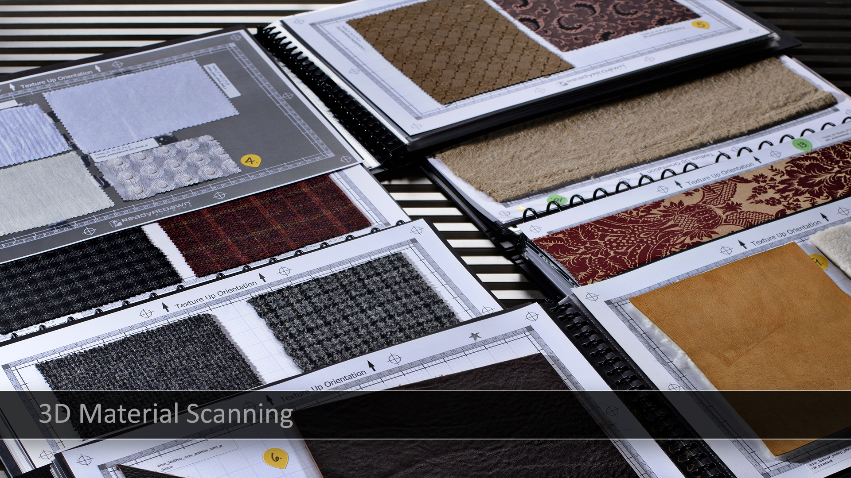
Notes:
Needed a fast solution for bringing in high quality detail maps into the engine quickly. Initially, we looked into off the shelf solutions but we found most laser scanning methods to be too noisy and not high enough resolution. We developed a material scanner in-house based on photometric stereo techniques to capture the high fidelity normal detail.

Slide 17
Play 3d Material Scanning Video

Slide 18
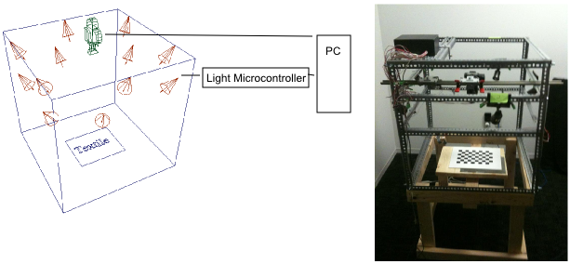
Scanning
Notes:
The scanner has a custom built light controller hooked up to the PC. The PC controls the lights and the camera to take pictures in unison. The pictures are stored on the PC and the normal/albedo solver is run after all 10 pictures from the 10 different lights have been collected.

Slide 19
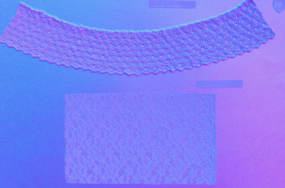
Scanning Calibration
Errors in calibration caused low frequency errors in solved normal map
Better estimation of parameters = better normals
Light direction
Light intensity
Geometric distortion
Radial distortion
Chromatic aberration
Notes:
If you’d like to learn more on how we calibrated the system please refer to the course notes

Slide 20
Material Authoring Pipeline
3 pillars of the material pipeline
Inheritance-based data format
Compositing
Run-time layering
Notes:
Add 3 stacked images representing each part. Or maybe, add a picture of the material editor

Slide 21
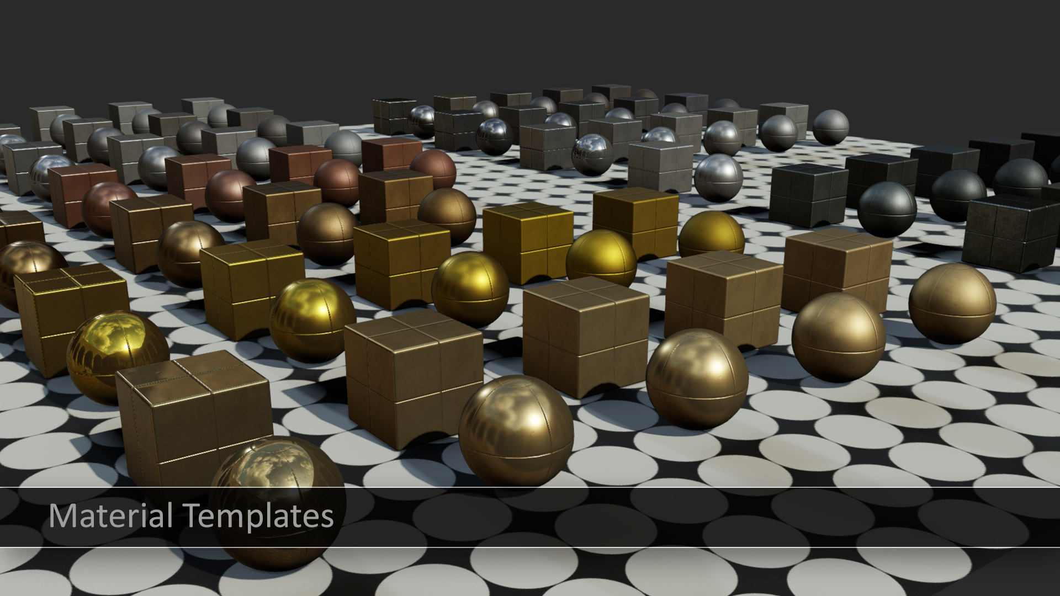

Slide 22
Inheritance-based Materials
Common parameters shared in base material
Derived material only stores changes from base
Quicker asset creation
Global changes can be made in a single asset

Slide 23
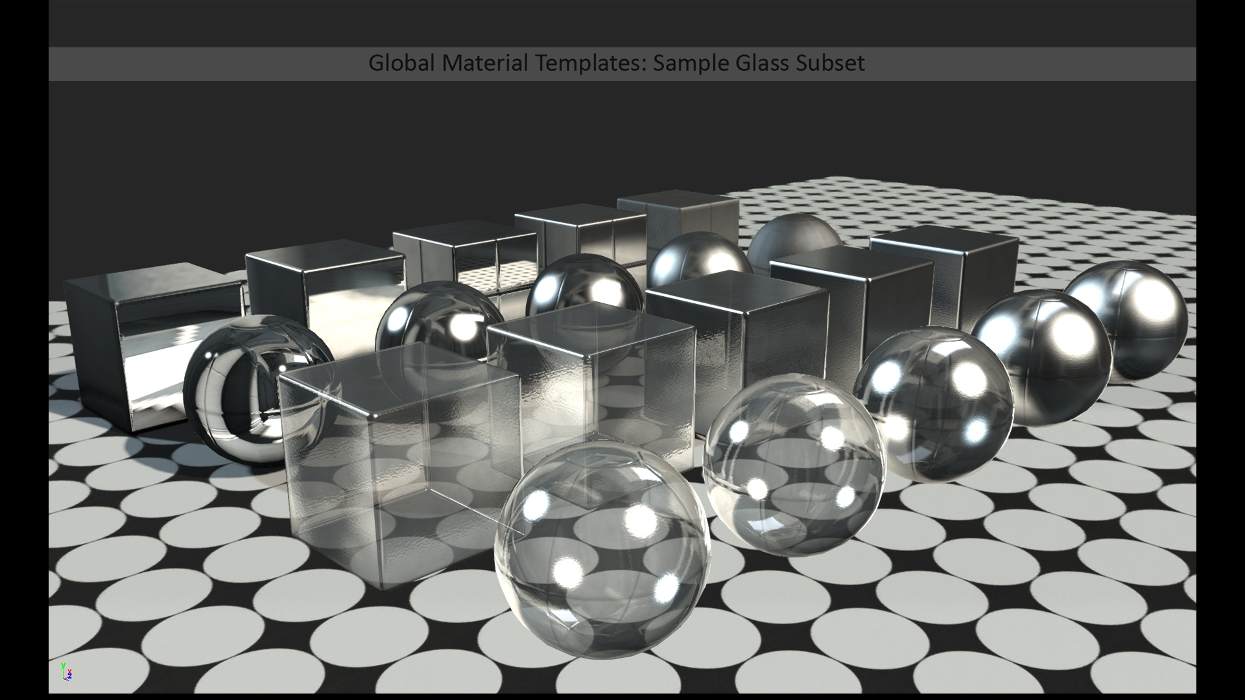
Notes:
Explain template system (templates are “pure” versions of materials, several variants of each template using inheritance, used as building blocks for compositing together complex materials)

Slide 24
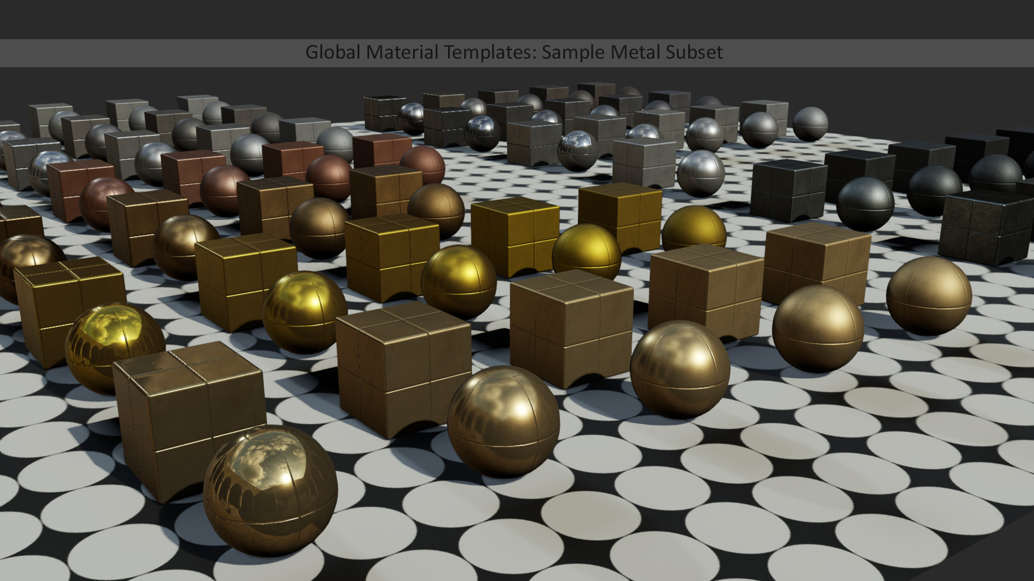
Notes:
Explain template system (templates are “pure” versions of materials, several variants of each template using inheritance, used as building blocks for compositing together complex materials)

Slide 25
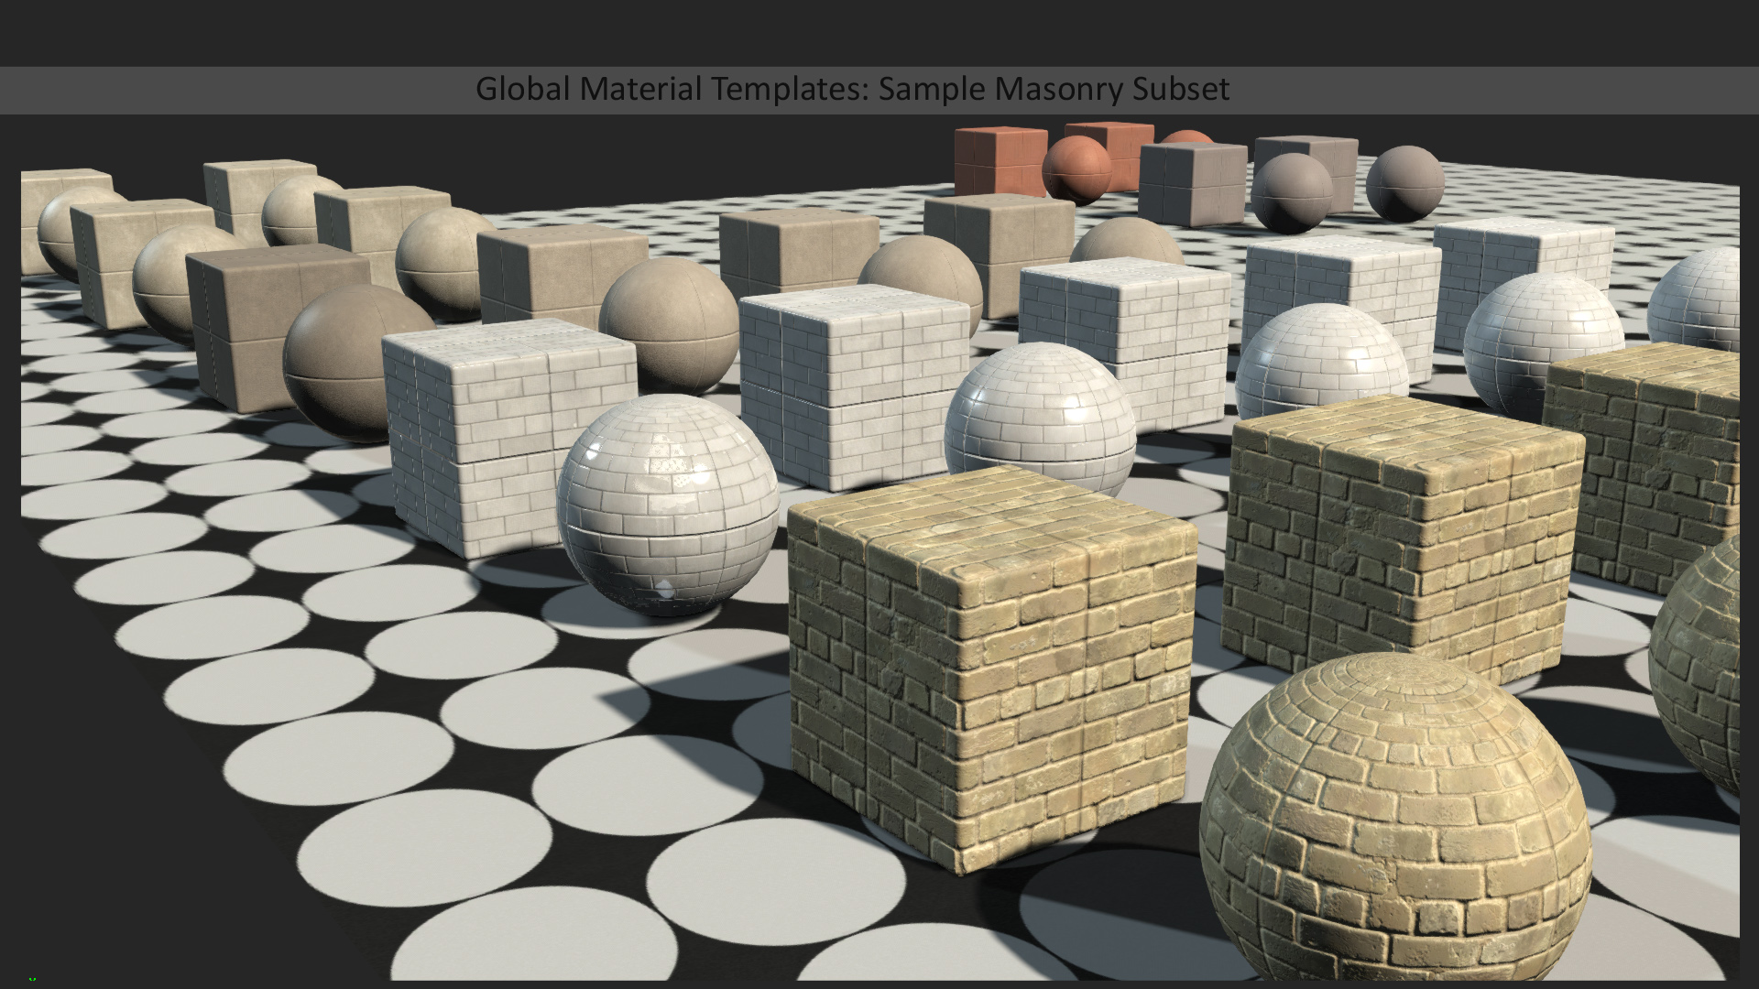
Notes:
Explain template system (templates are “pure” versions of materials, several variants of each template using inheritance, used as building blocks for compositing together complex materials)

Slide 26
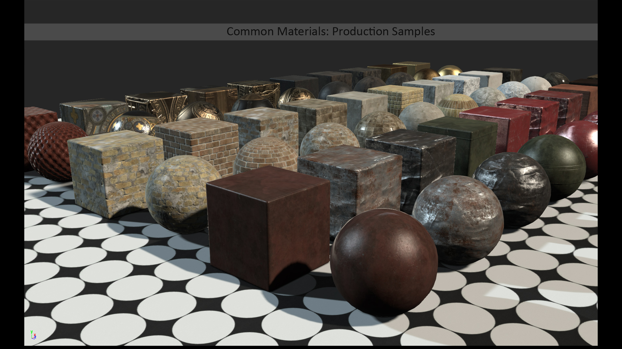
Notes:
Explain template system (templates are “pure” versions of materials, several variants of each template using inheritance, used as building blocks for compositing together complex materials)

Slide 27
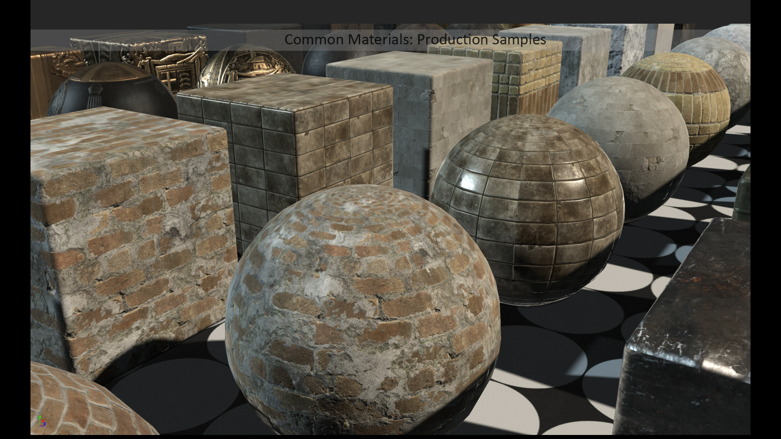
Notes:
Explain template system (templates are “pure” versions of materials, several variants of each template using inheritance, used as building blocks for compositing together complex materials)

Slide 28
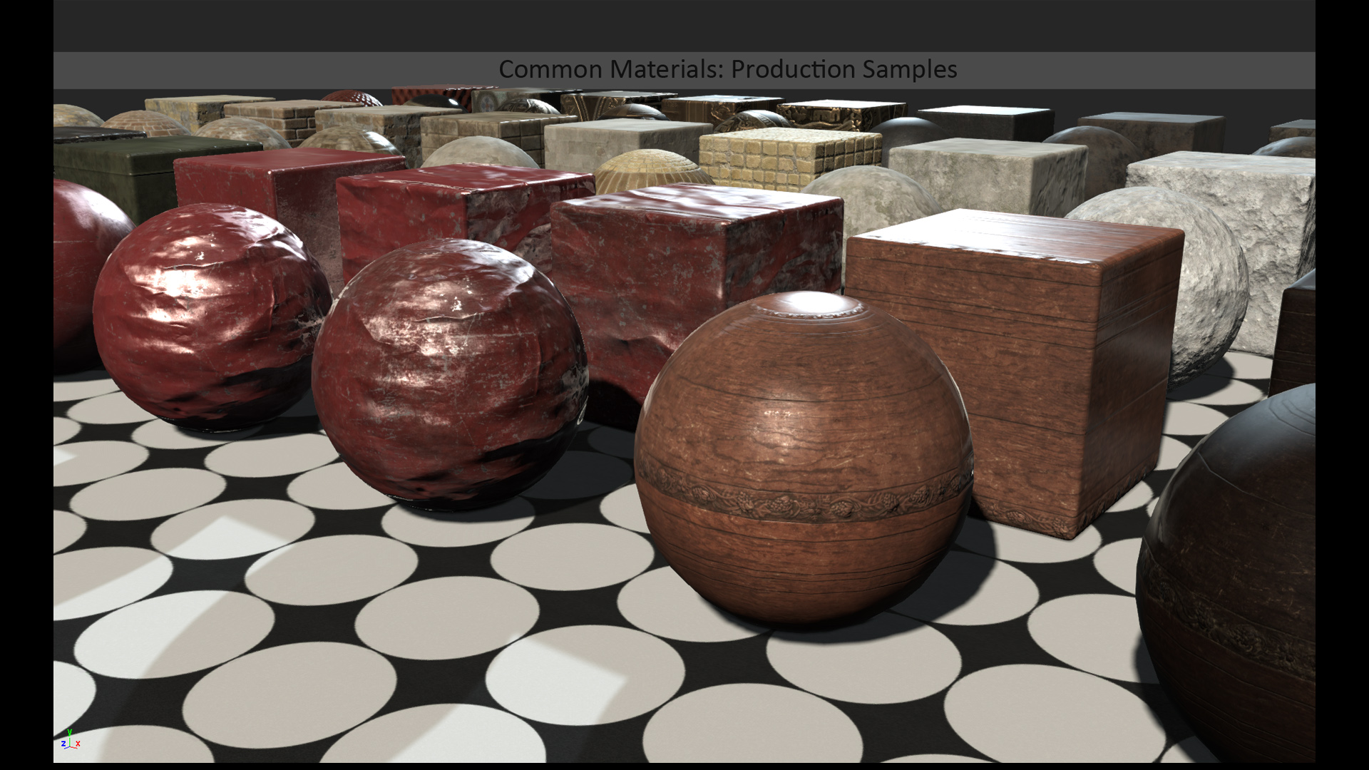
Notes:
Explain template system (templates are “pure” versions of materials, several variants of each template using inheritance, used as building blocks for compositing together complex materials)

Slide 29
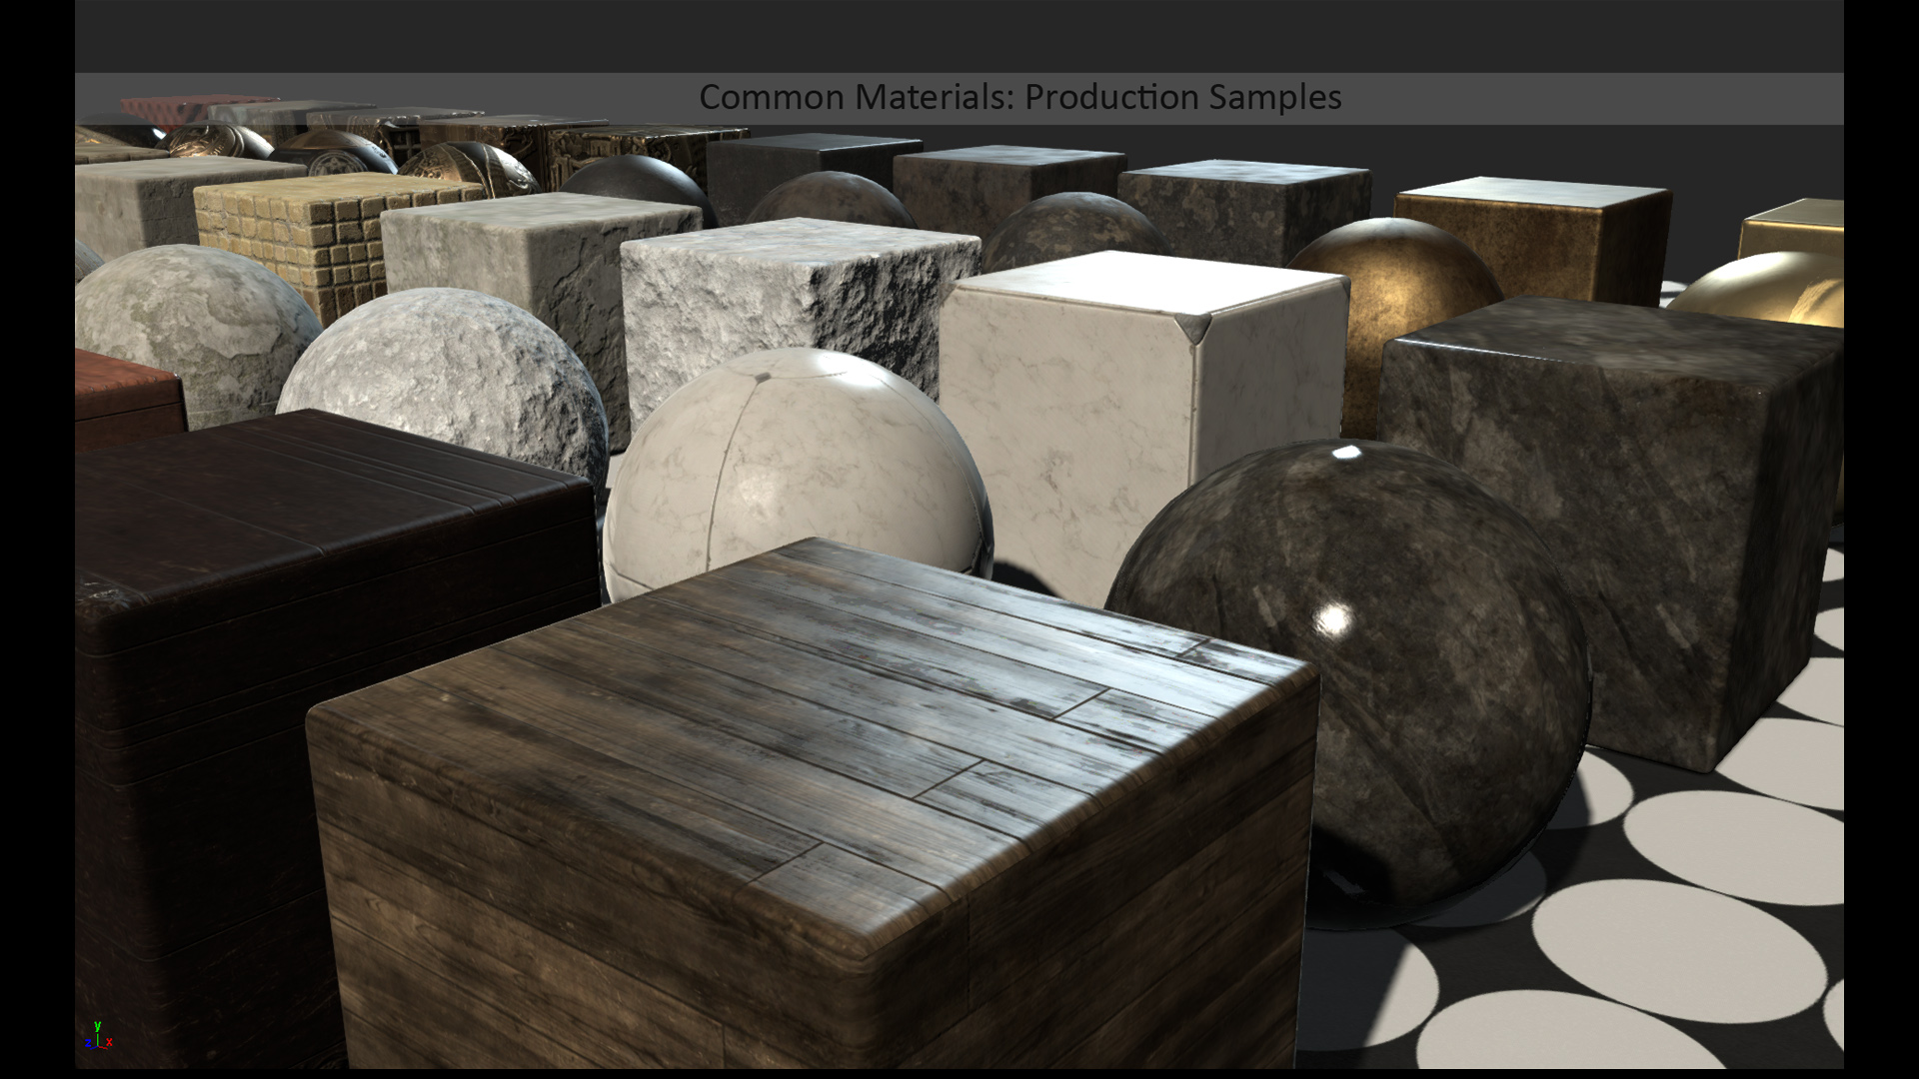
Notes:
Explain template system (templates are “pure” versions of materials, several variants of each template using inheritance, used as building blocks for compositing together complex materials)

Slide 30
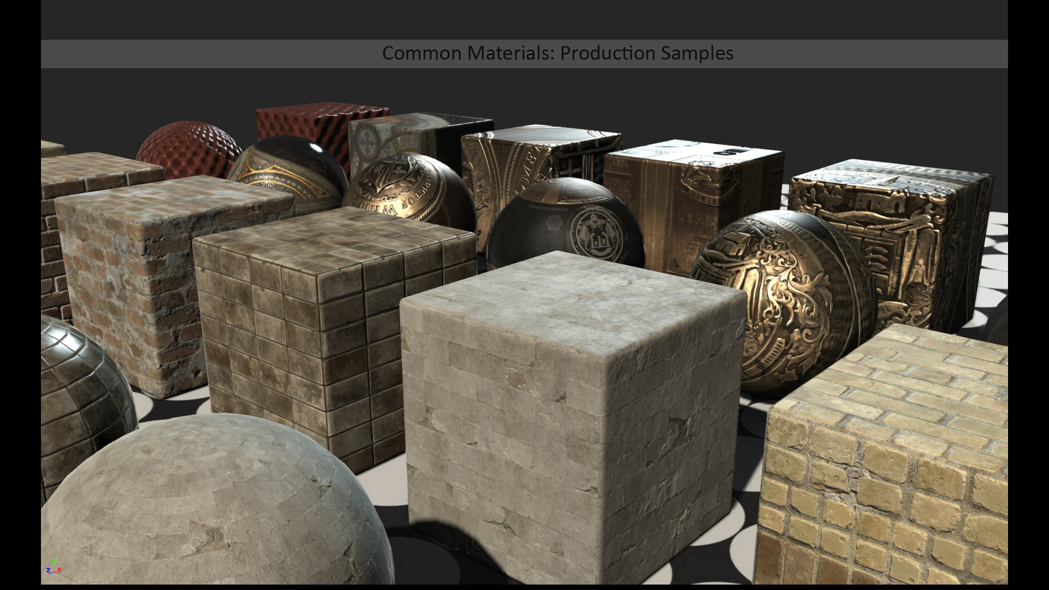
Notes:
Explain template system (templates are “pure” versions of materials, several variants of each template using inheritance, used as building blocks for compositing together complex materials)

Slide 31
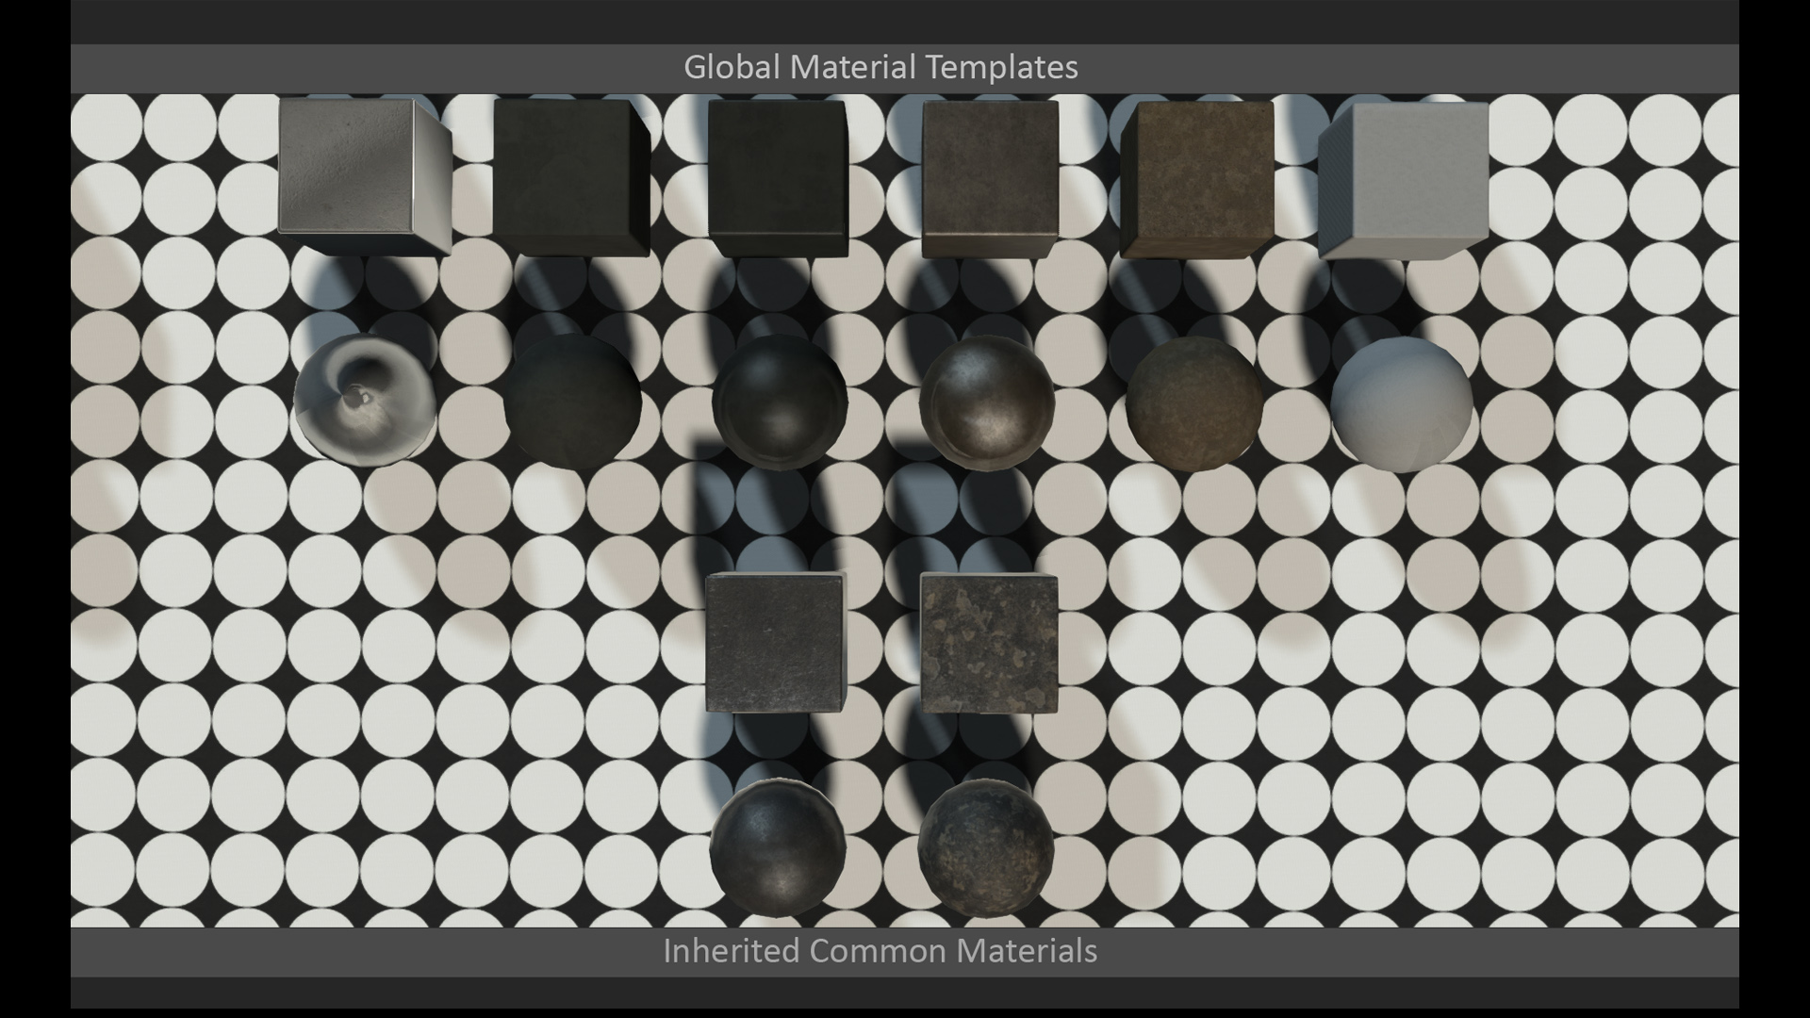
Notes:
Explain template system (templates are “pure” versions of materials, several variants of each template using inheritance, used as building blocks for compositing together complex materials)

Slide 32
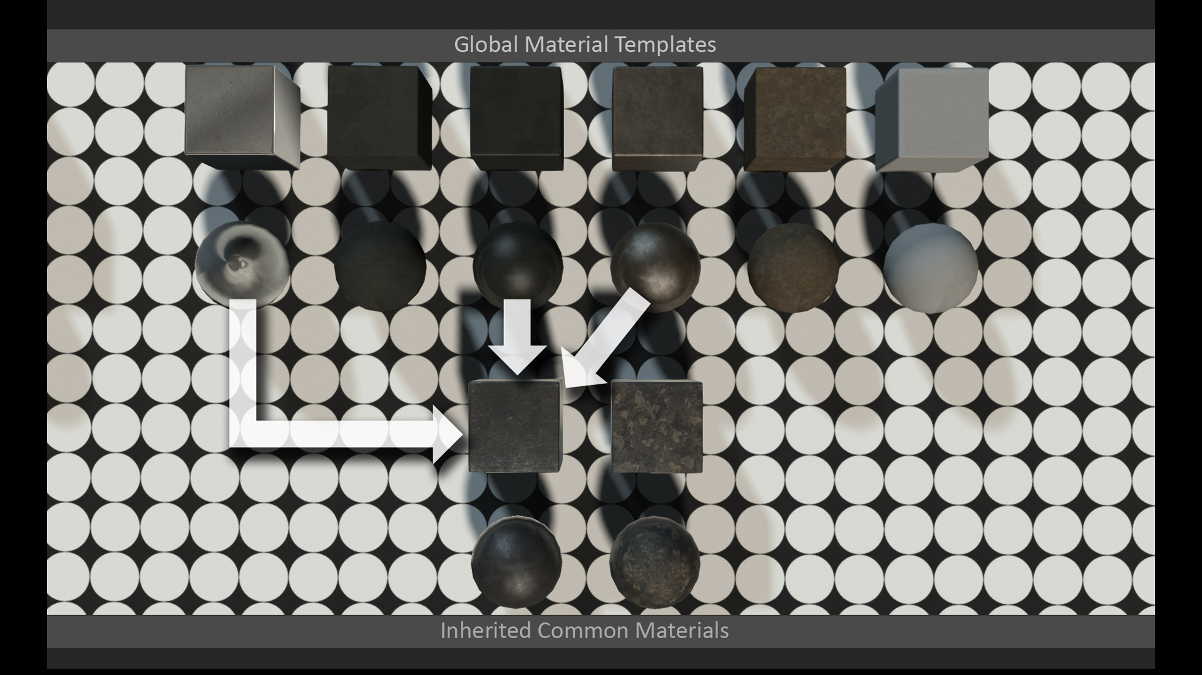
Notes:
Explain template system (templates are “pure” versions of materials, several variants of each template using inheritance, used as building blocks for compositing together complex materials)

Slide 33
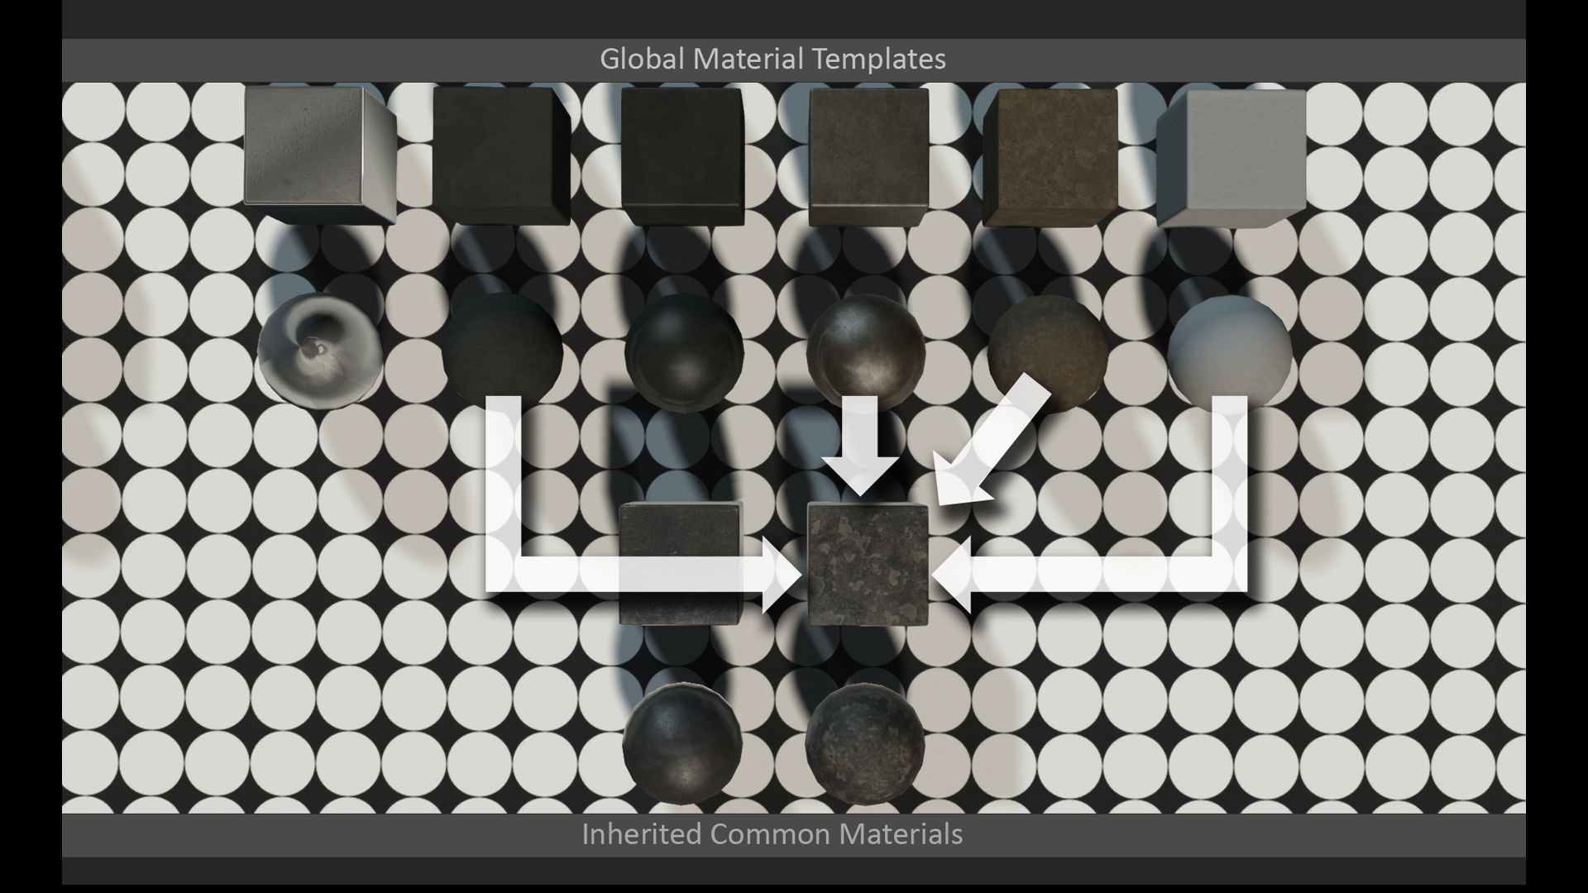
Notes:
Explain template system (templates are “pure” versions of materials, several variants of each template using inheritance, used as building blocks for compositing together complex materials)

Slide 34
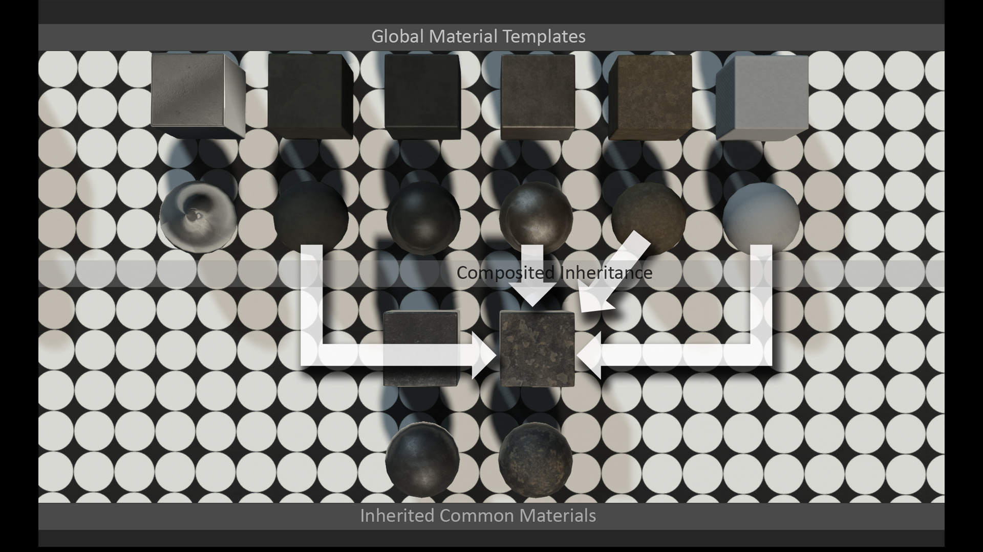
Notes:
Explain template system (templates are “pure” versions of materials, several variants of each template using inheritance, used as building blocks for compositing together complex materials)

Slide 35
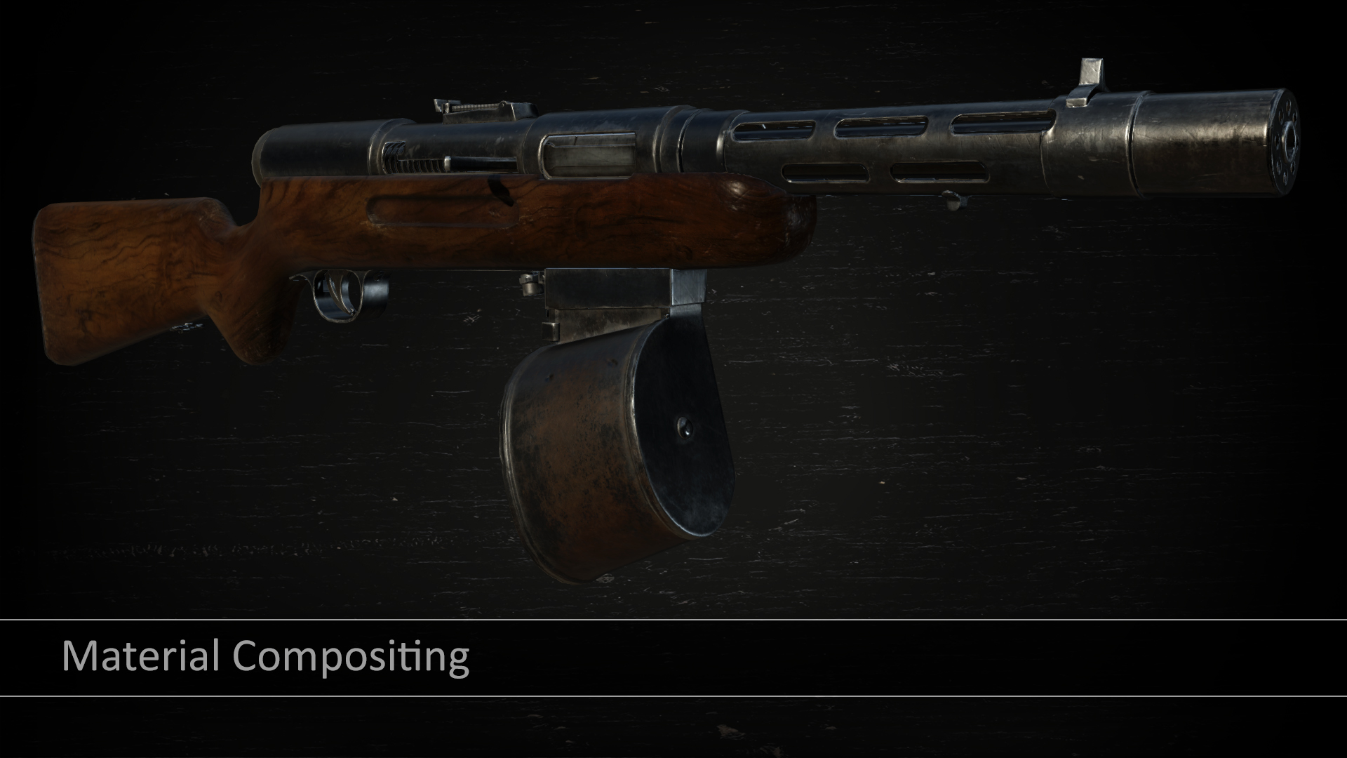

Slide 36
Material Compositing
Mostly offline process
Generates parameter maps from materials and blending maps
Support compositing subset of BRDFs
Cloth, GGX, and Anisotropic
Compositing cloth requires applying 2 BRDFs
Notes:
Now we will talk about our material compositing pipeline, which is colloquially referred to as “The Smasher” around the office.
Compositing is an offline process for generating parameter maps for materials, none of it is performed at runtime. Essentially in our material editor we allow for a “stack” of composited materials, similar to a series of layers in Photoshop. The material parameters from those layers are then used to generate texture maps containing parameter values. The parameter values can come from textures in the source materials, or from parameters defined in the material asset file. The blending of parameters is controlled by blend masks provided for each layer in the stack, as well as a few other controls. Everything could really be done in Photoshop if you wanted to, but it would be much more cumbersome.
We also support compositing materials with different BRDFs, but only for a subset of our BRDFs. Anisotropic and GGX are similar since they’re essentially the same BRDF, but cloth was more tricky. Currently for cloth compositing we compute lighting twice, once with the cloth BRDF and again with GGX, and then blend the results using a blending map generated by the compositing pipeline.

Slide 37
Material Compositing
Map | R Channel | G Channel | B Channel | A Channel | Format
1 | Normals X | Normals Y | N/A | N/A | BC5
2 | Diffuse R | Diffuse G | Diffuse B | Alpha (Optional) | BC1 or BC3
3 | Specular R | Specular G | Specular B | Specular Intensity | BC3
4 | Roughness | AO | BRDF Blend | Anisotropy | BC3
Notes:
These are the texture maps output by our compositing pipeline. Other parameters supported by our material model, such as RGB opacity, can be specified in the material itself but will not be composited using the blend maps.

Slide 38
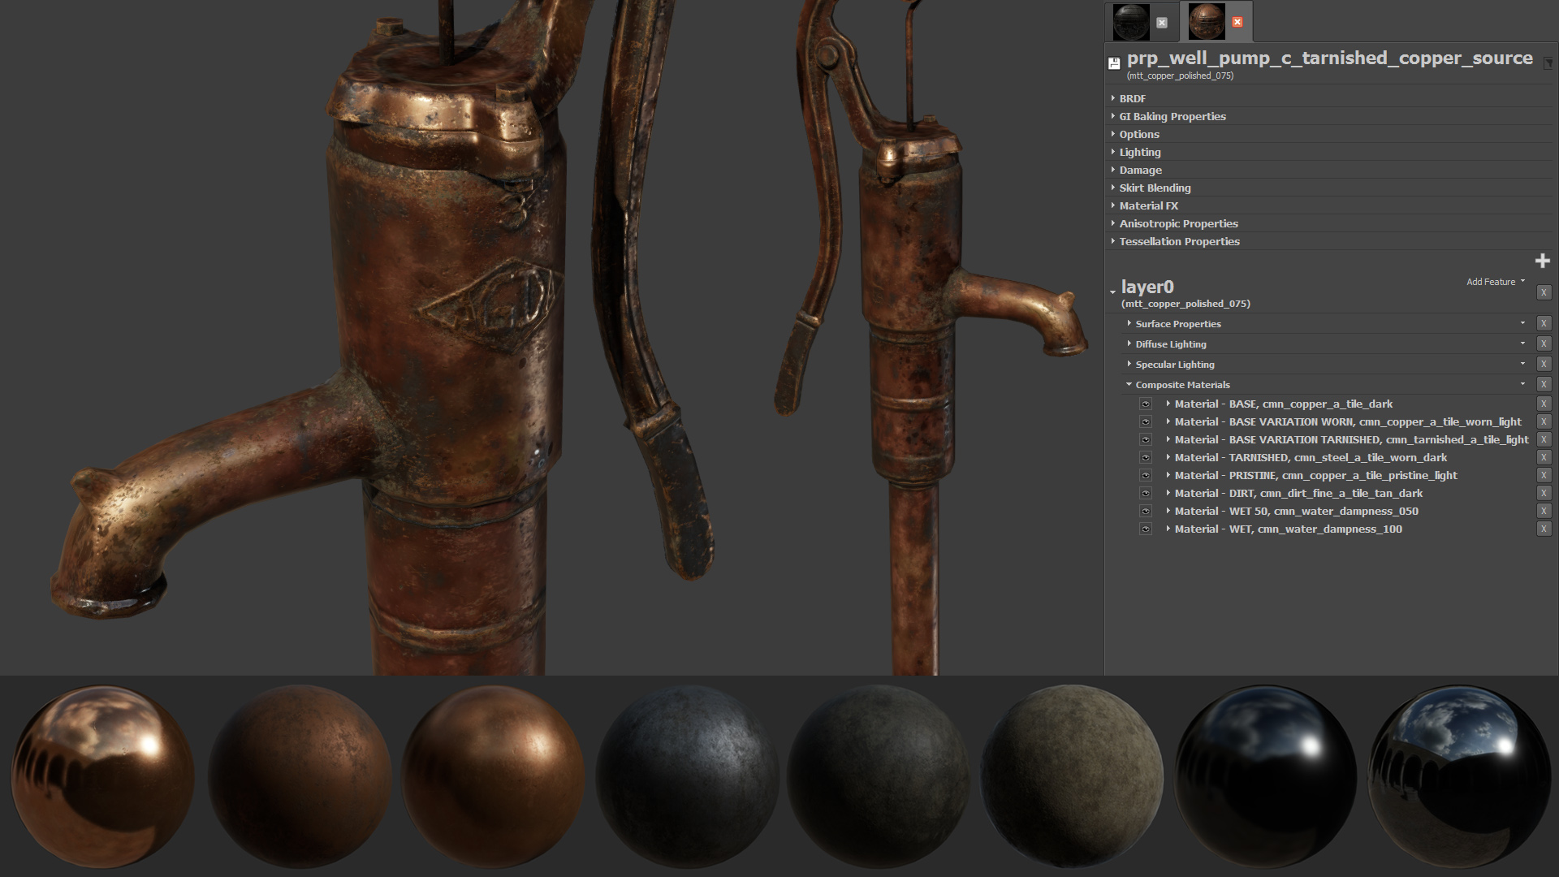

Slide 39
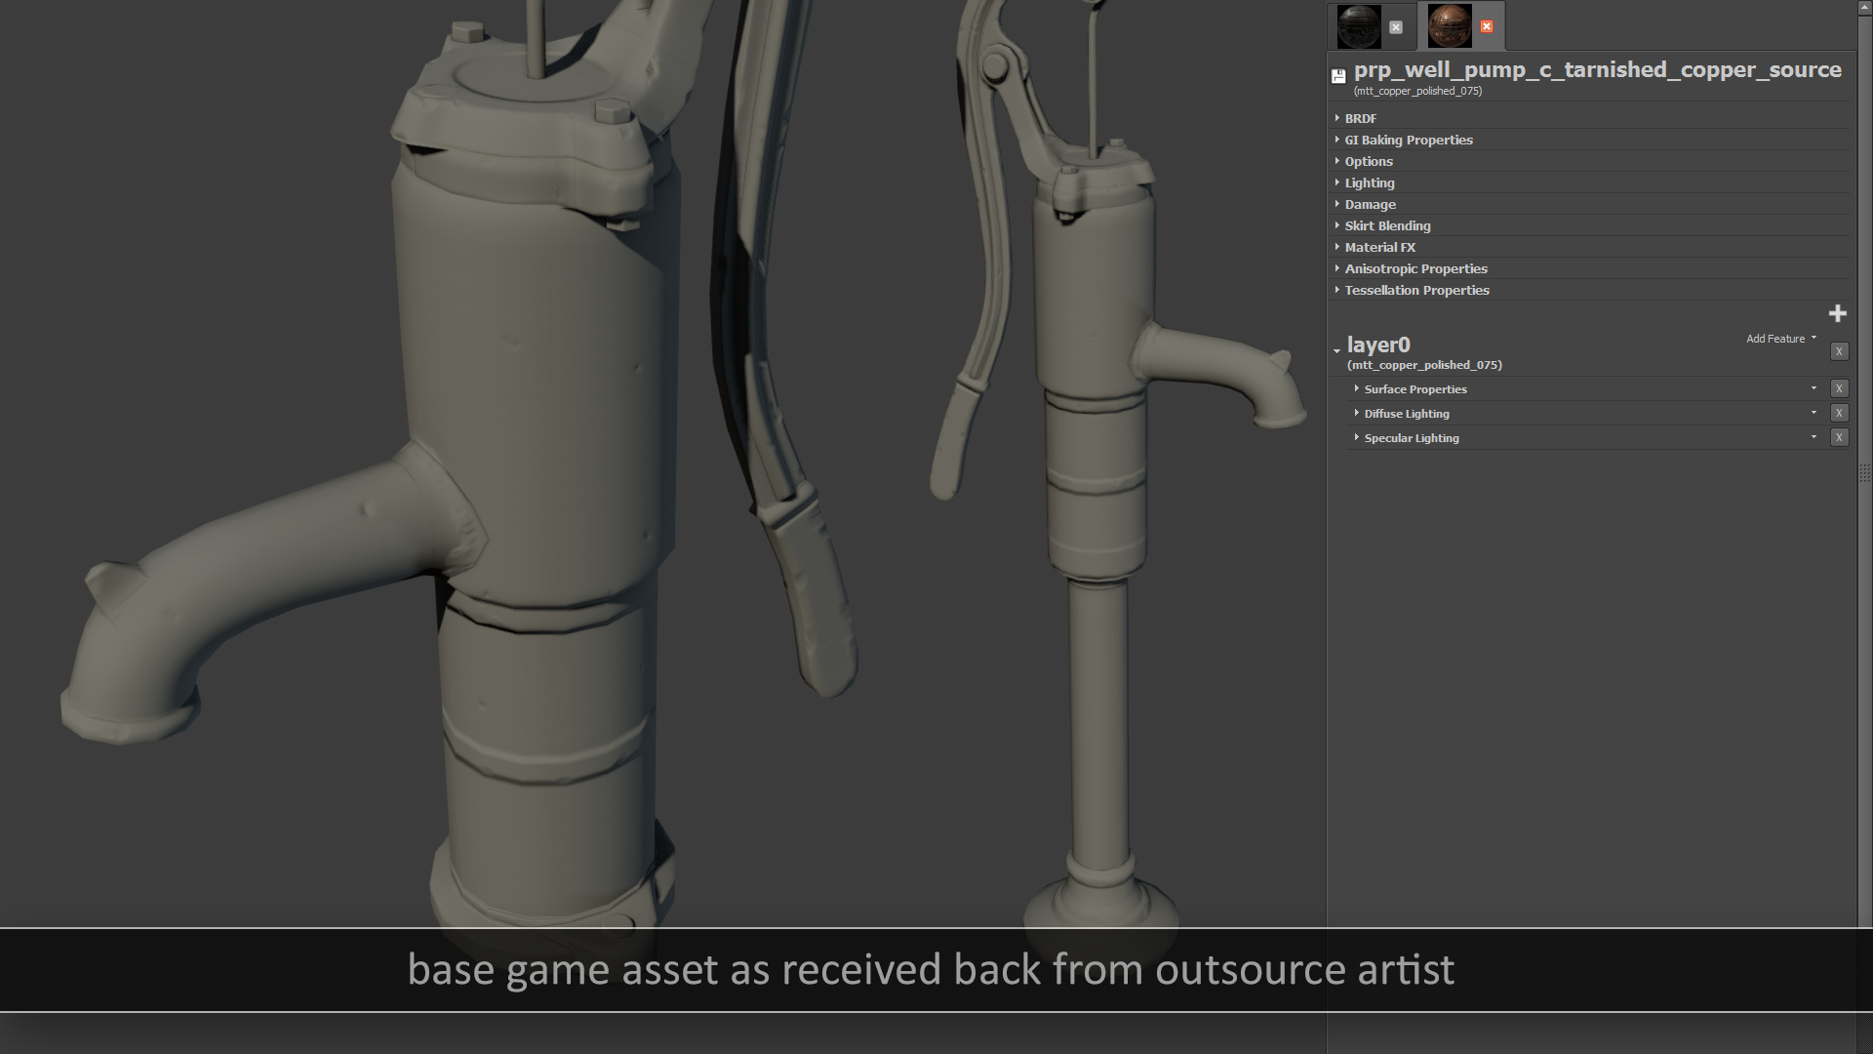

Slide 40
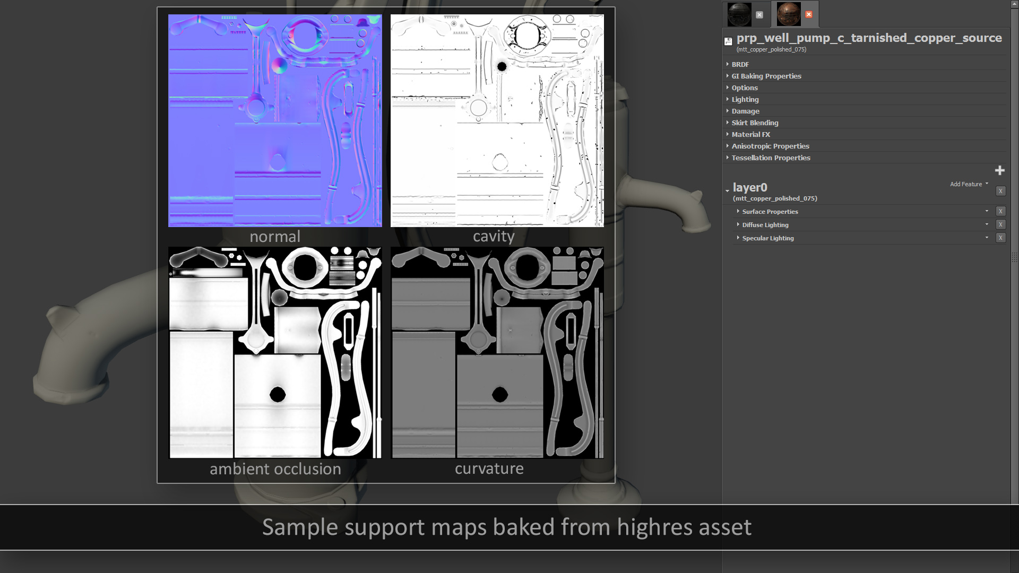

Slide 41
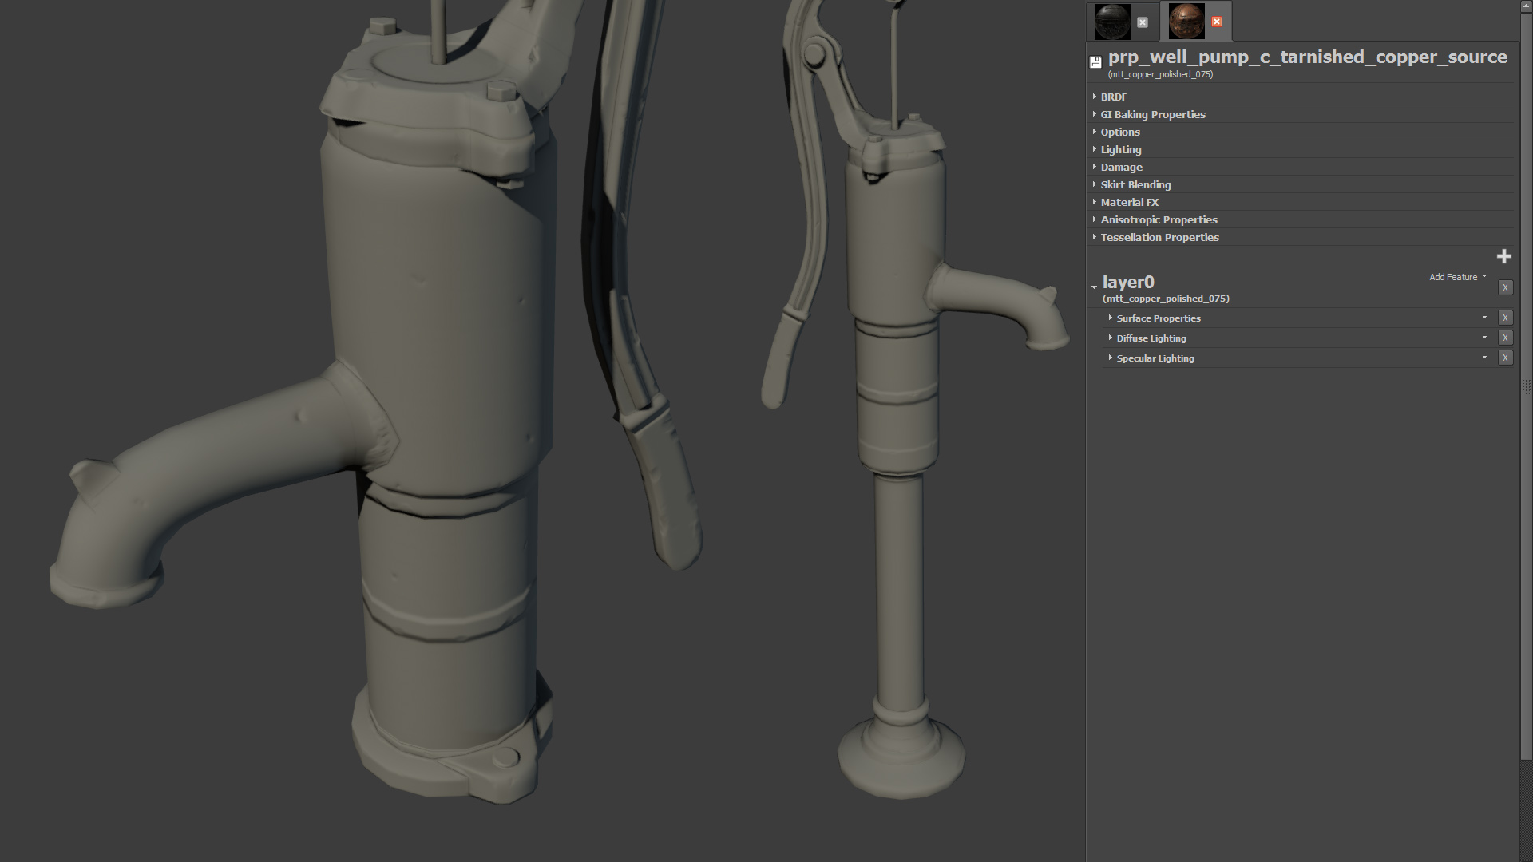

Slide 42
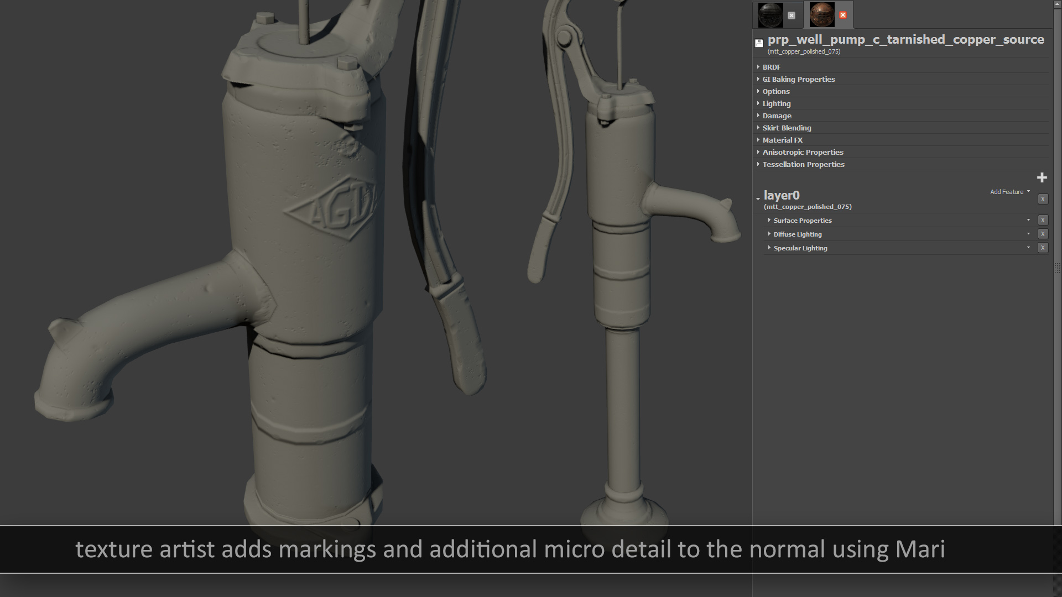

Slide 43
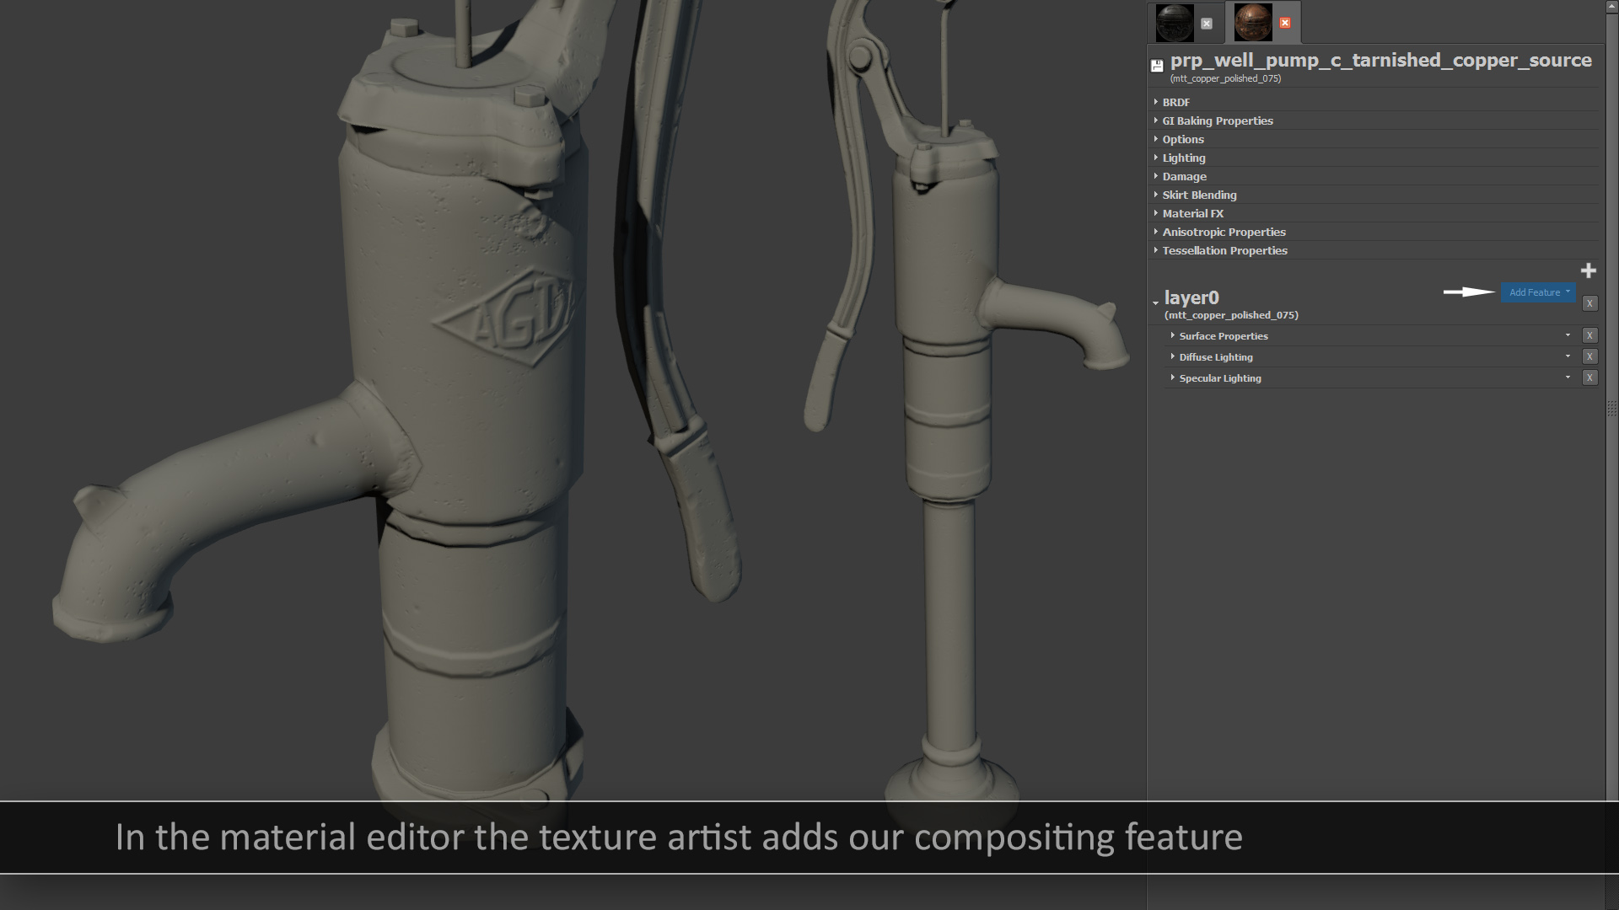

Slide 44
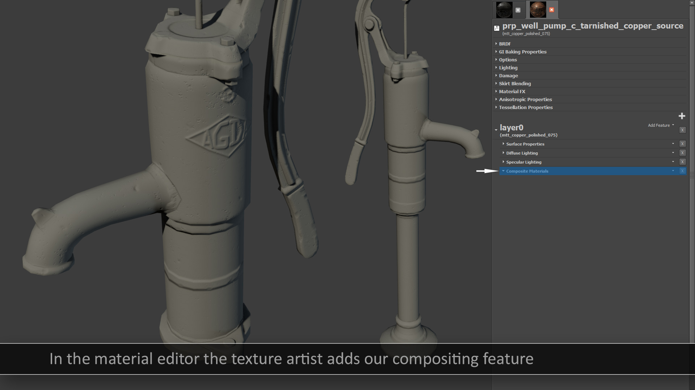

Slide 45
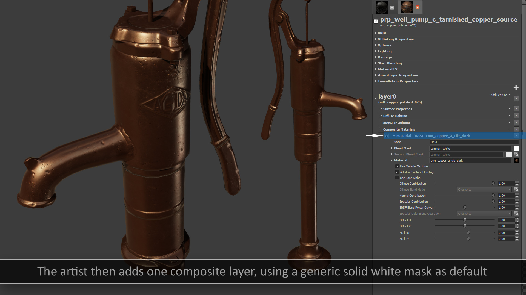

Slide 46
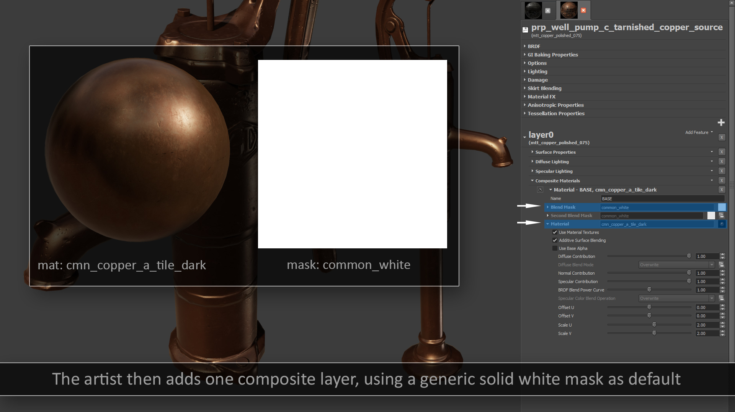

Slide 47
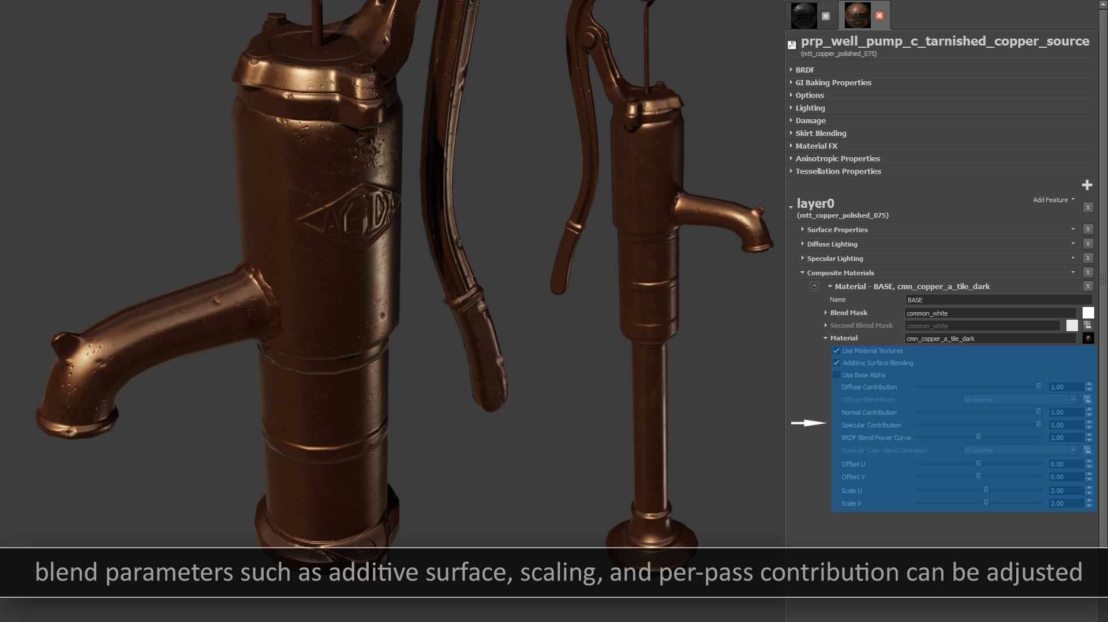

Slide 48
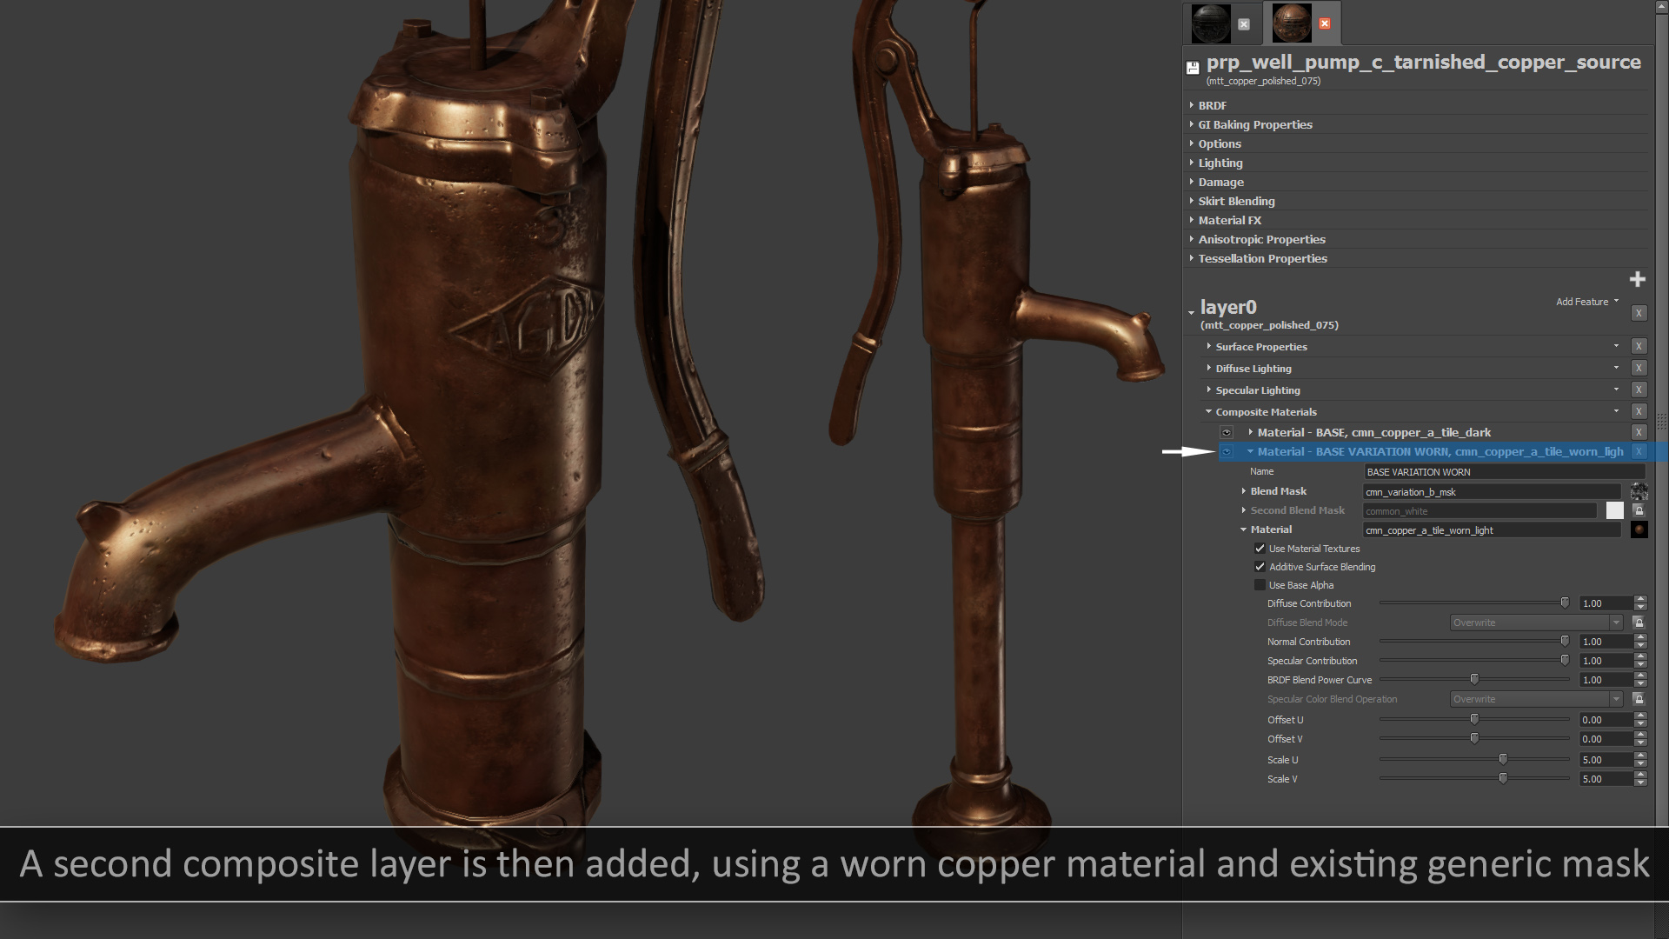

Slide 49
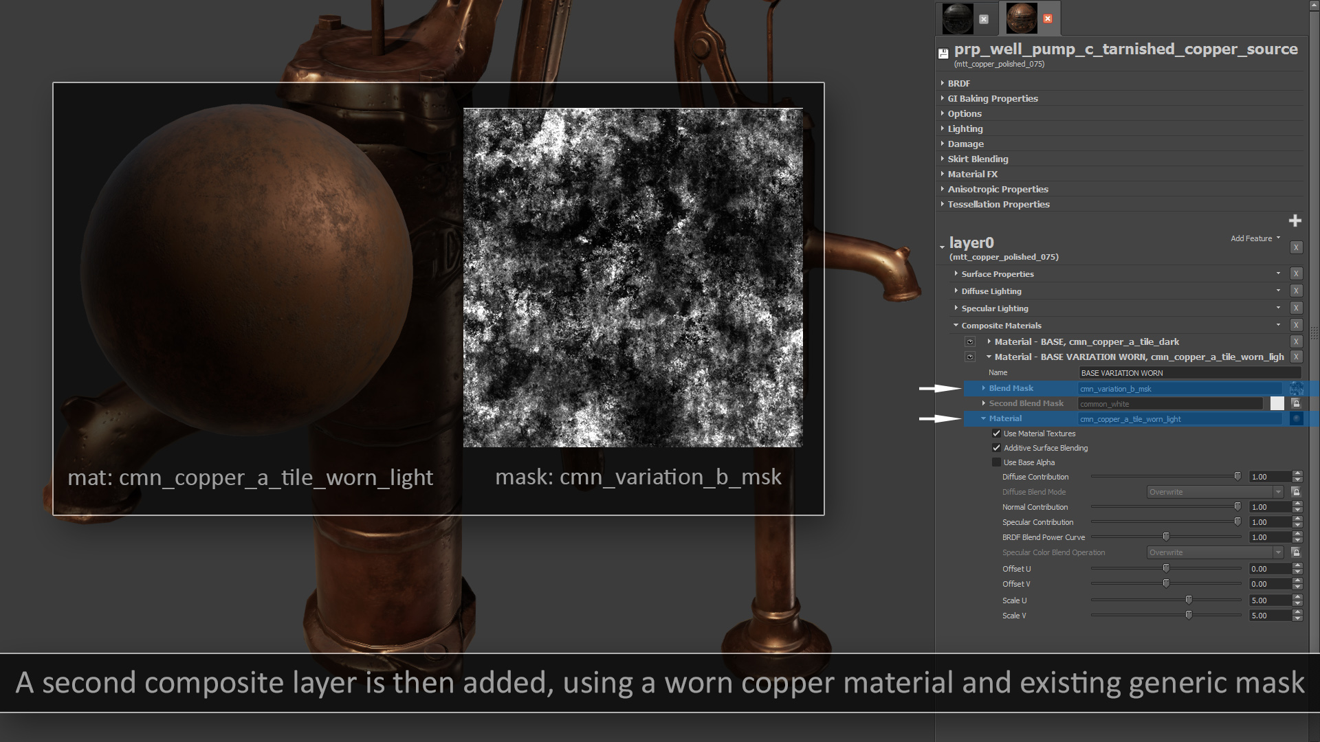

Slide 50
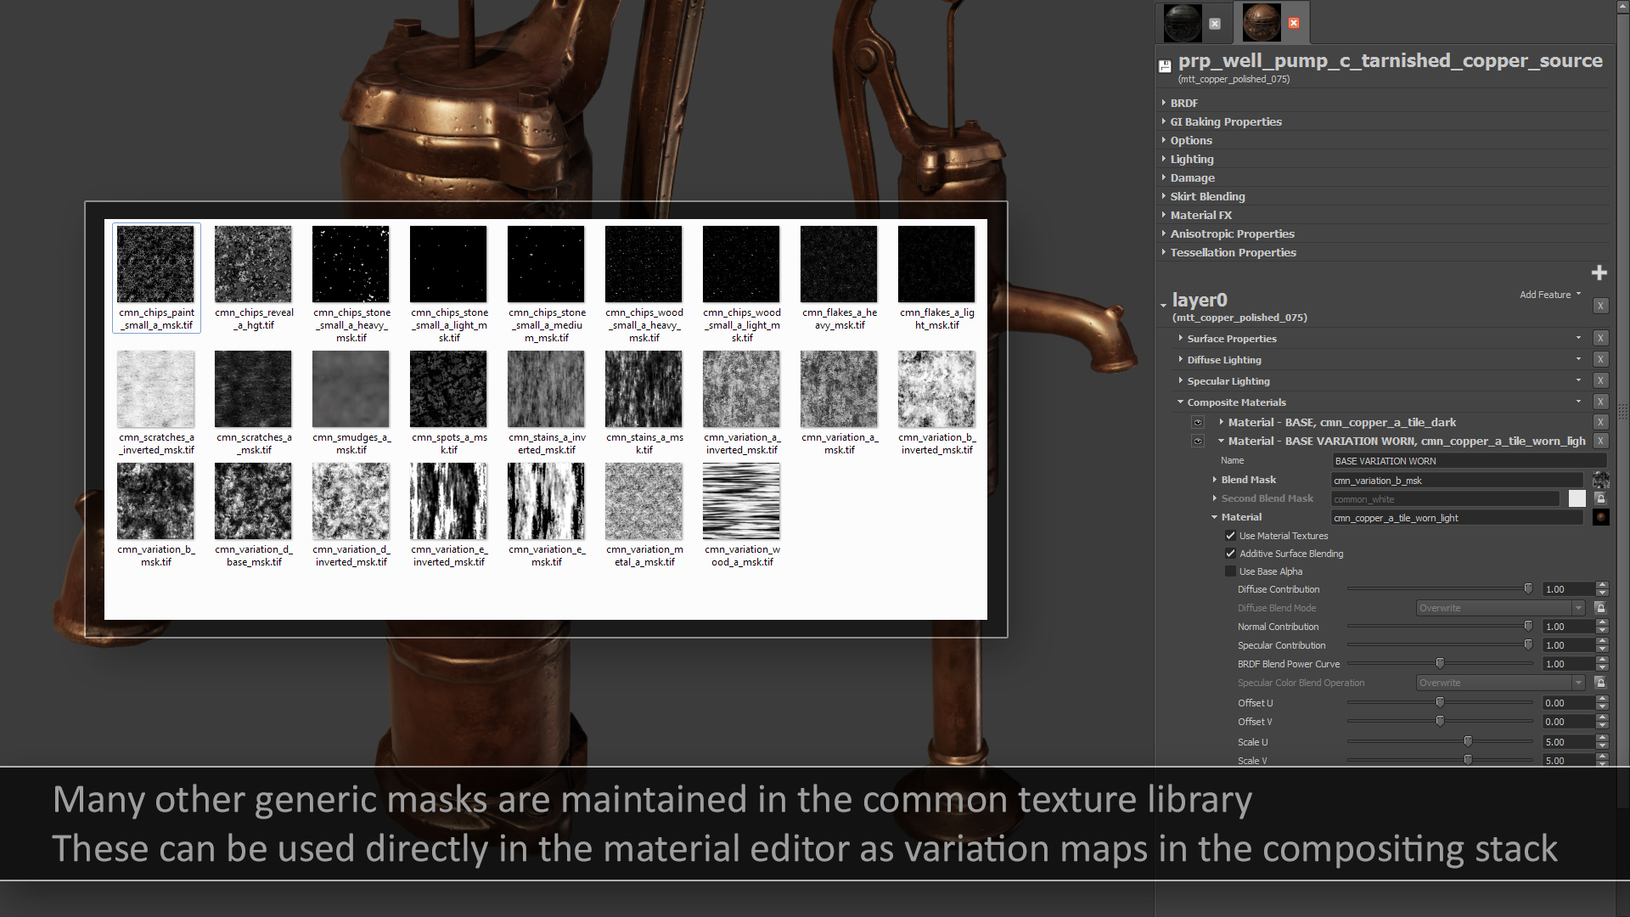

Slide 51
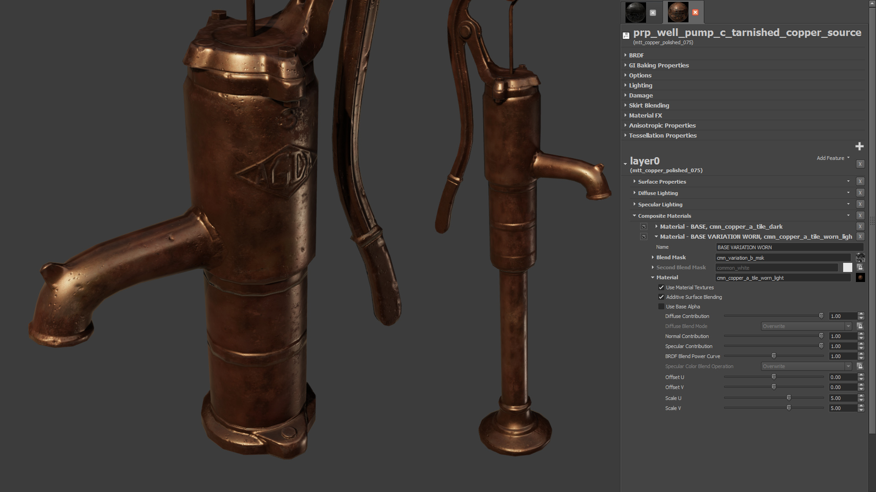

Slide 52
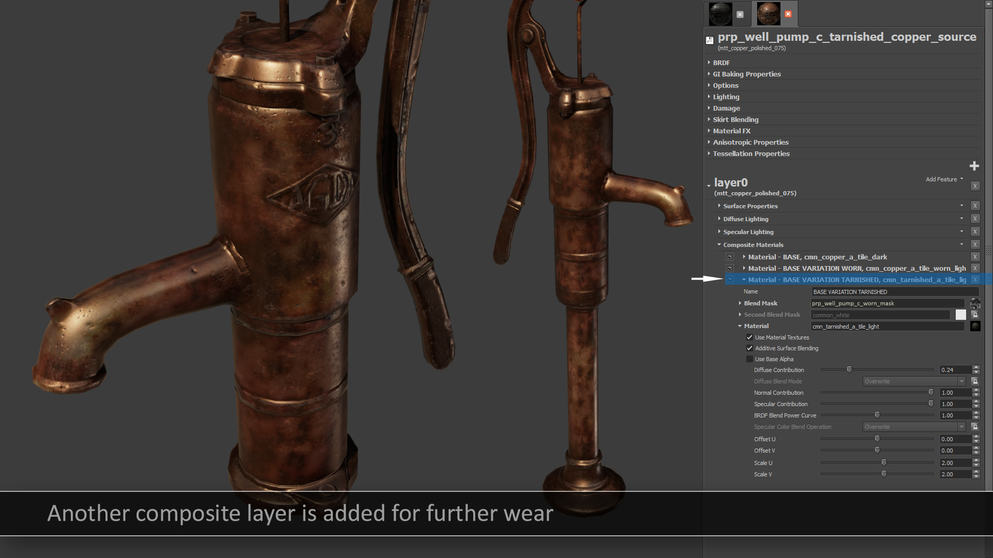

Slide 53


Slide 54


Slide 55


Slide 56


Slide 57


Slide 58


Slide 59


Slide 60


Slide 61


Slide 62


Slide 63


Slide 64


Slide 65


Slide 66


Slide 67


Slide 69


Slide 70

Material Layers
Up to 4 layers
Derived from base materials
Separate compositing chain per layer
Driven by vertex colors
Notes:
Our materials also support a runtime layer-blending system. We support up to 4 layers per material, and each layer has full inheritance and compositing support. Typically an artist will derive a layer from a base material asset, which allows them to quickly assemble multi-layered materials from completely unique material assets. The contribution of each layer is primarily driven by dedicated vertex color channel, which is used in conjunction with blend maps and height maps to determine the final alpha value. In certain cases we also blend in layers based on runtime-generated maps. One notable example of this is our a damage system, which uses accumulated bullet decals to gradually reveal an underlying layer on environment materials.
On the right is a screenshot of a multi-layer material being edited

Slide 71

Material Layers
Notes:
Here we have an example of runtime layering being used in one of our test levels. The base layer is a tiling brick material, which would look boring and repetitive on its own. To add some break up and variety, a layer of thick mortar is blended in on top of the brick. Finally we have a layer of wetness and water that’s added on top of both of the mortar and the brick. Since our game takes place in London, wet bricks and stone is something that we find ourselves using quite often.

Slide 72
Future Work
Compositing of other BRDF types
Cheaper compositing of multiple BRDFs
Improved Specular AA approximations
Multiple specular lobes
Better diffuse BRDFs

Slide 73
Specular AA Sample App
https://mjp.codeplex.com/releases/view/109905

Slide 74


